Slide 1
Mr. Warren looks for a
RAINBOW

Slide 2
Mr. Warren went to the forest to look
for a RAINBOW!

Slide 3
insect
“Is this a rainbow?“ asks Mr. Warren.

Slide 4
mountain
“Is this a rainbow?“ asks Mr. Warren.

Slide 5
waterfall
“Is this a rainbow?“ asks Mr. Warren.

Slide 6
plant
“Is this a rainbow?“ asks Mr. Warren.

Slide 7
bird
“Is this a rainbow?“ asks Mr. Warren.

Slide 8
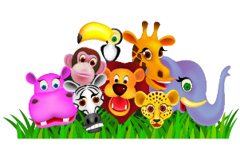
animals
“Is this a rainbow?“ asks Mr. Warren.

Slide 9
tree
“Is this a rainbow?“ asks Mr. Warren.

Slide 10
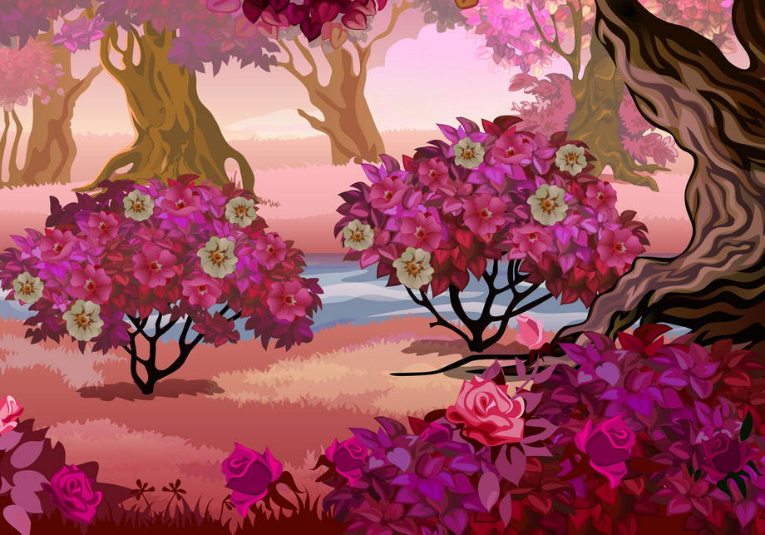
flowers
“Is this a rainbow?“ asks Mr. Warren.

Slide 11
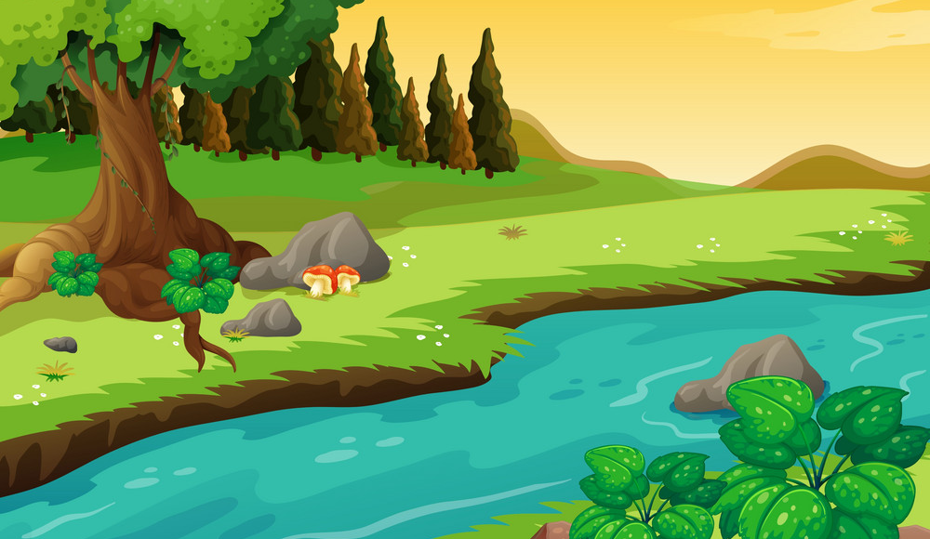
river
“Is this a rainbow?“ asks Mr. Warren.

Slide 12
rainbow
“Is this a rainbow?“ asks Mr. Warren.

Slide 13
“YES IT IS!“ shouts Mr. Warren.

Slide 14
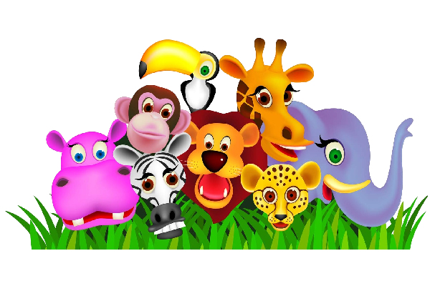
animals
plant
tree
mountain
insect
flower
bird
river
waterfall

