Slide 1
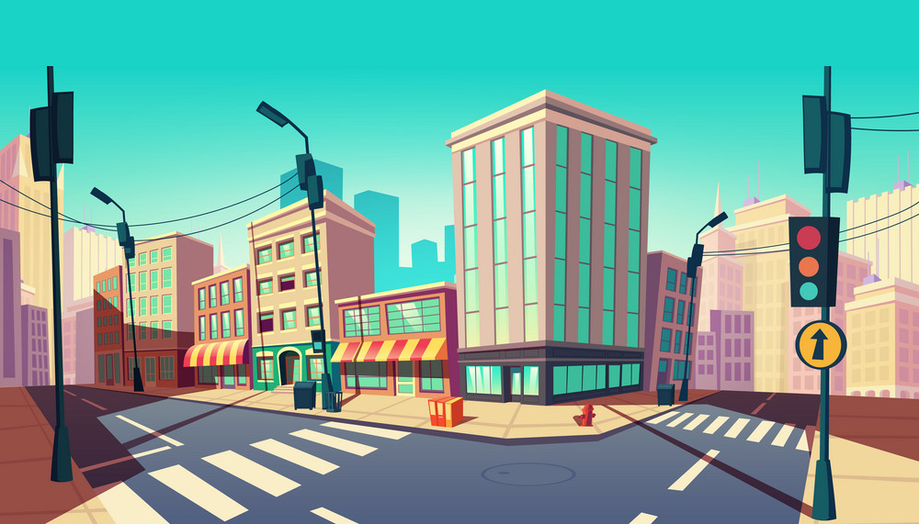
Mr. Warren’s
Tricky Transport

Slide 2
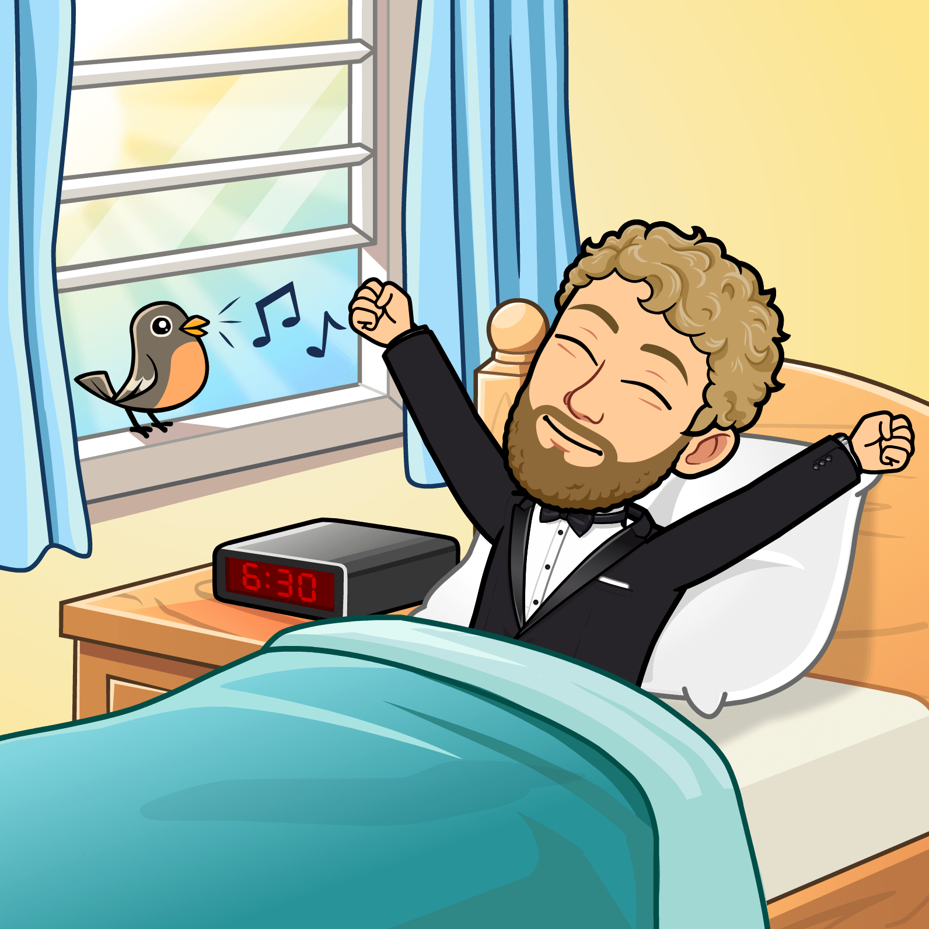
Mr. Warren
wakes up
ready to
meet his
friend for
a party.

Slide 3
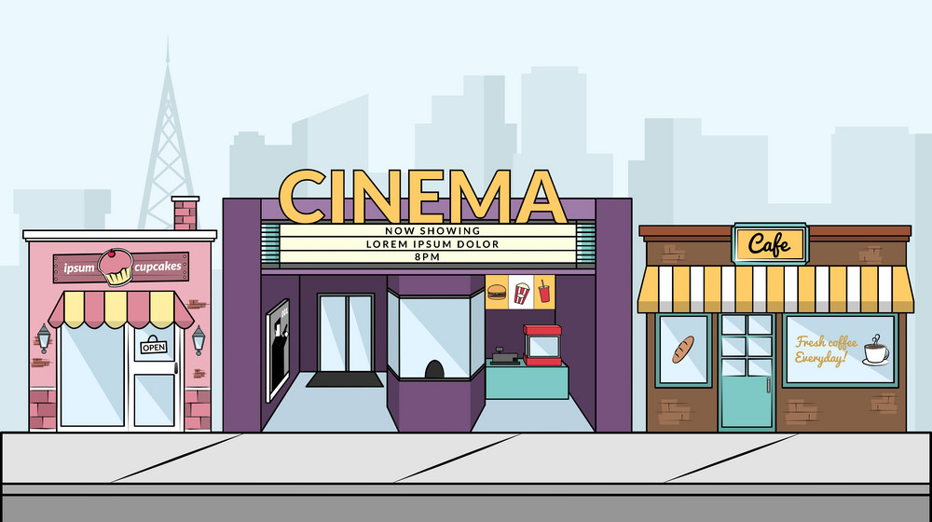
Mr. Warren goes by foot.

Slide 4
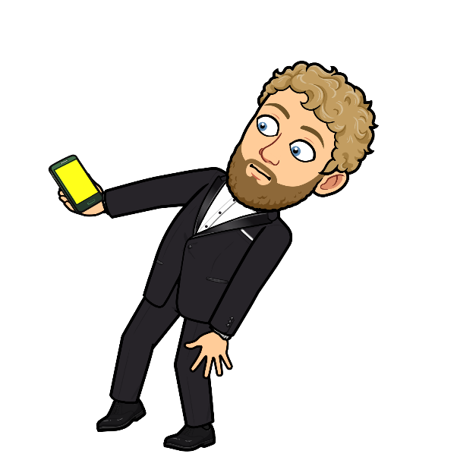
Mr. Warren realized that he was
late to meet his friend!

Slide 5
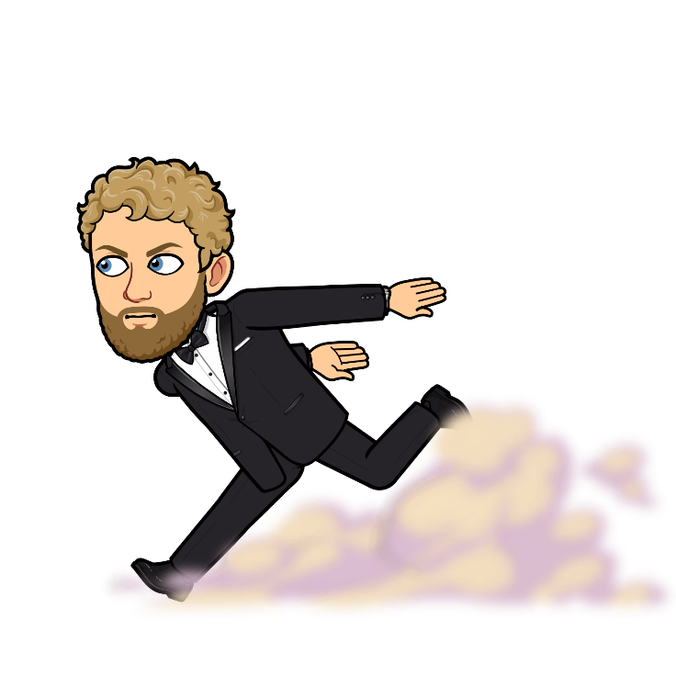
Mr. Warren ran as fast as he
could to try and not be late.

Slide 6
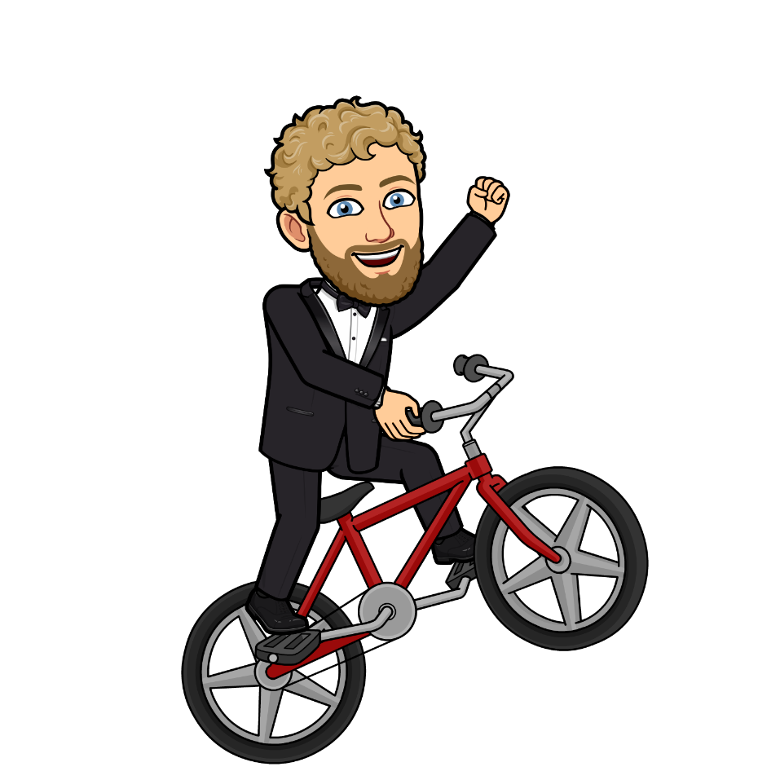
Mr. Warren goes by bicycle.

Slide 7
Mr. Warren goes by ferry.

Slide 8
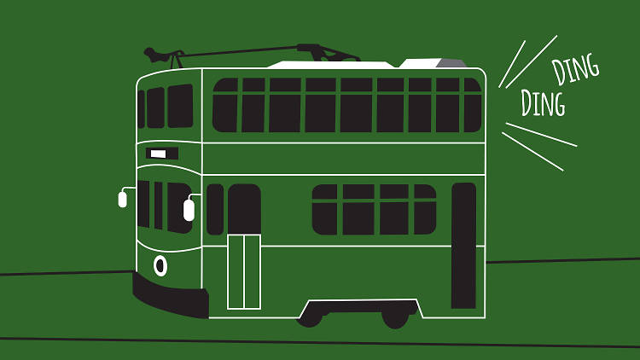
Mr. Warren goes by tram.

Slide 9
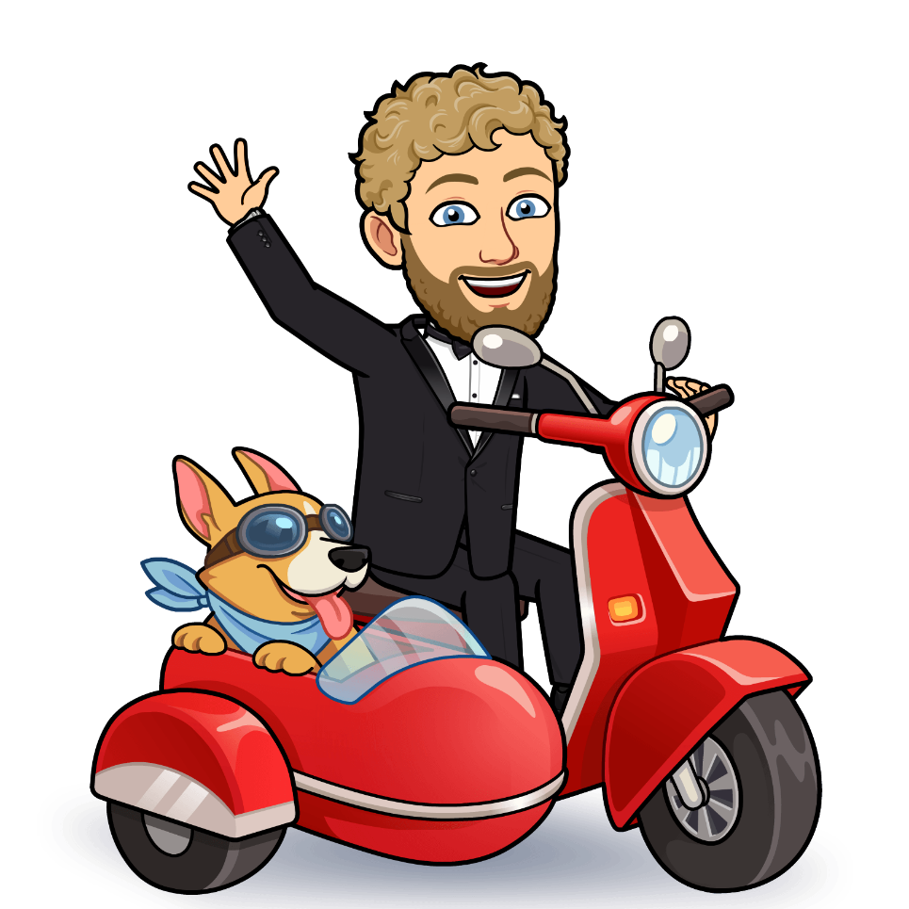
Mr. Warren goas by motorcycle.

Slide 10
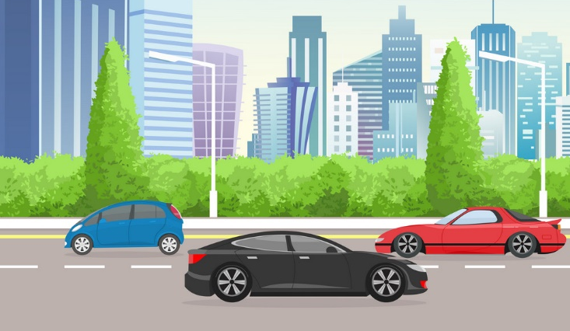
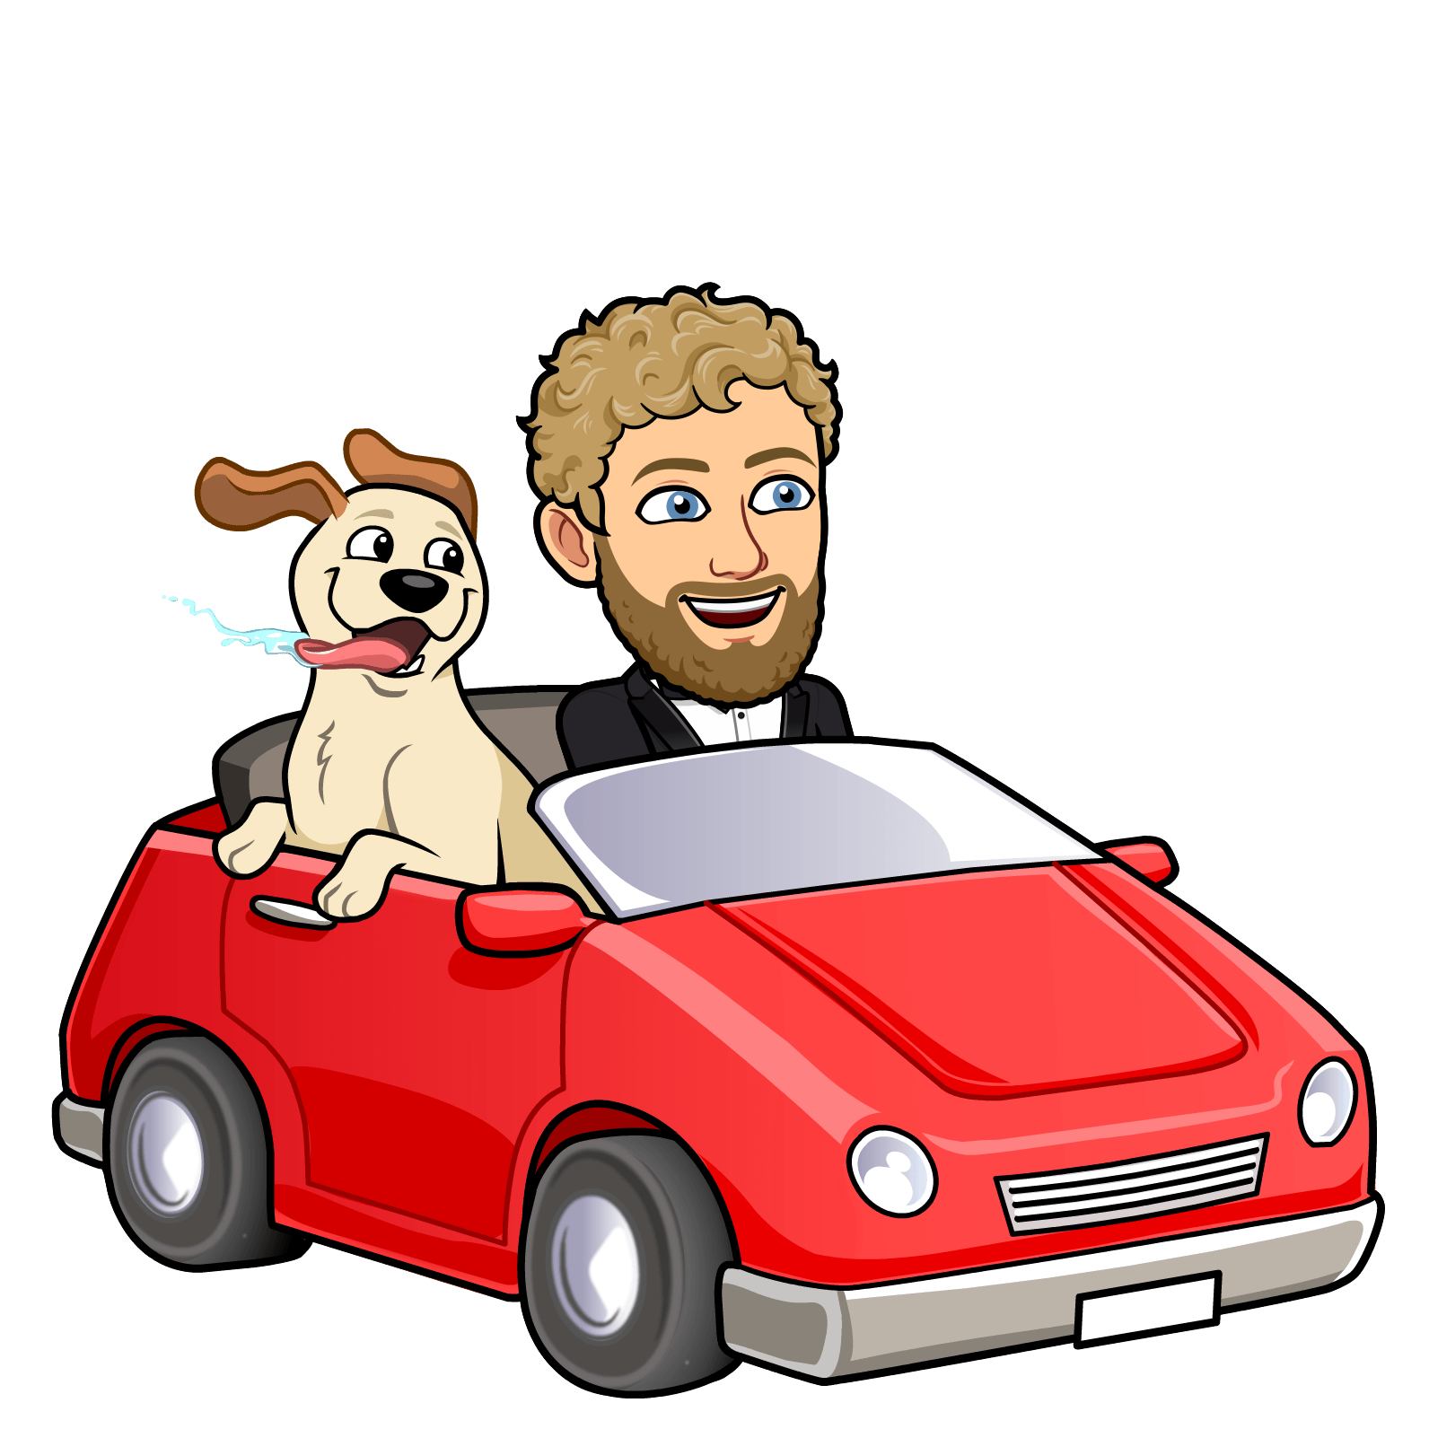
Mr. Warren goes by car.

Slide 11
Mr. Warren
goes by
bus.

Slide 12
Mr. Warren goes by train.

Slide 13
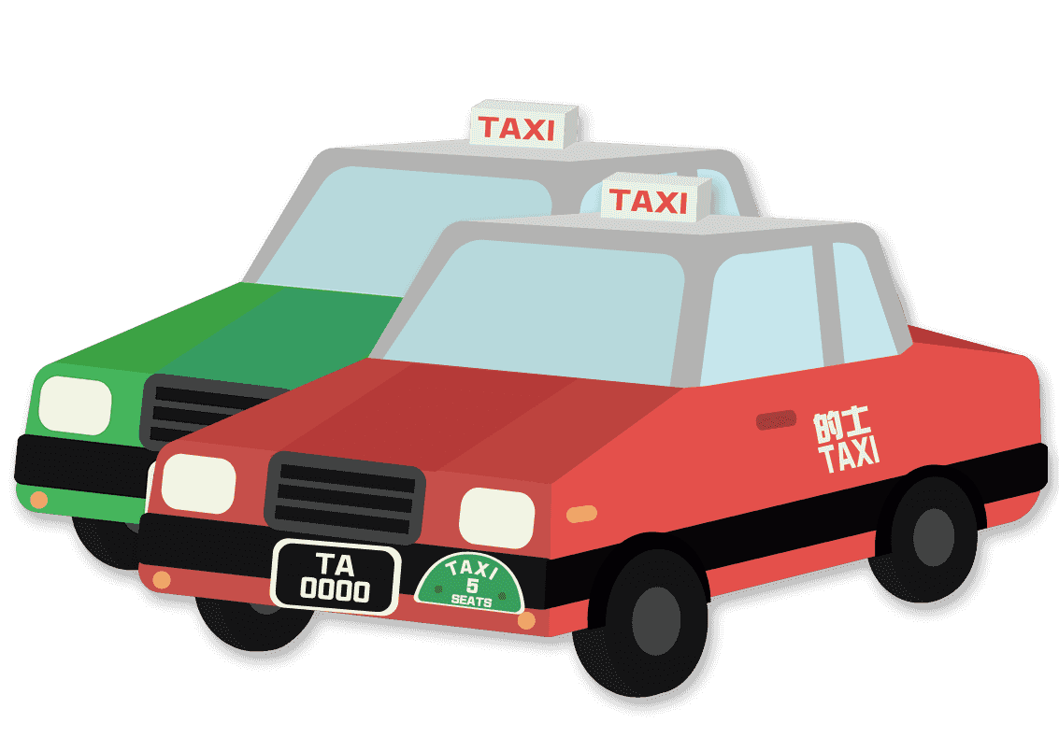
Mr. Warren goes by taxi.

Slide 14
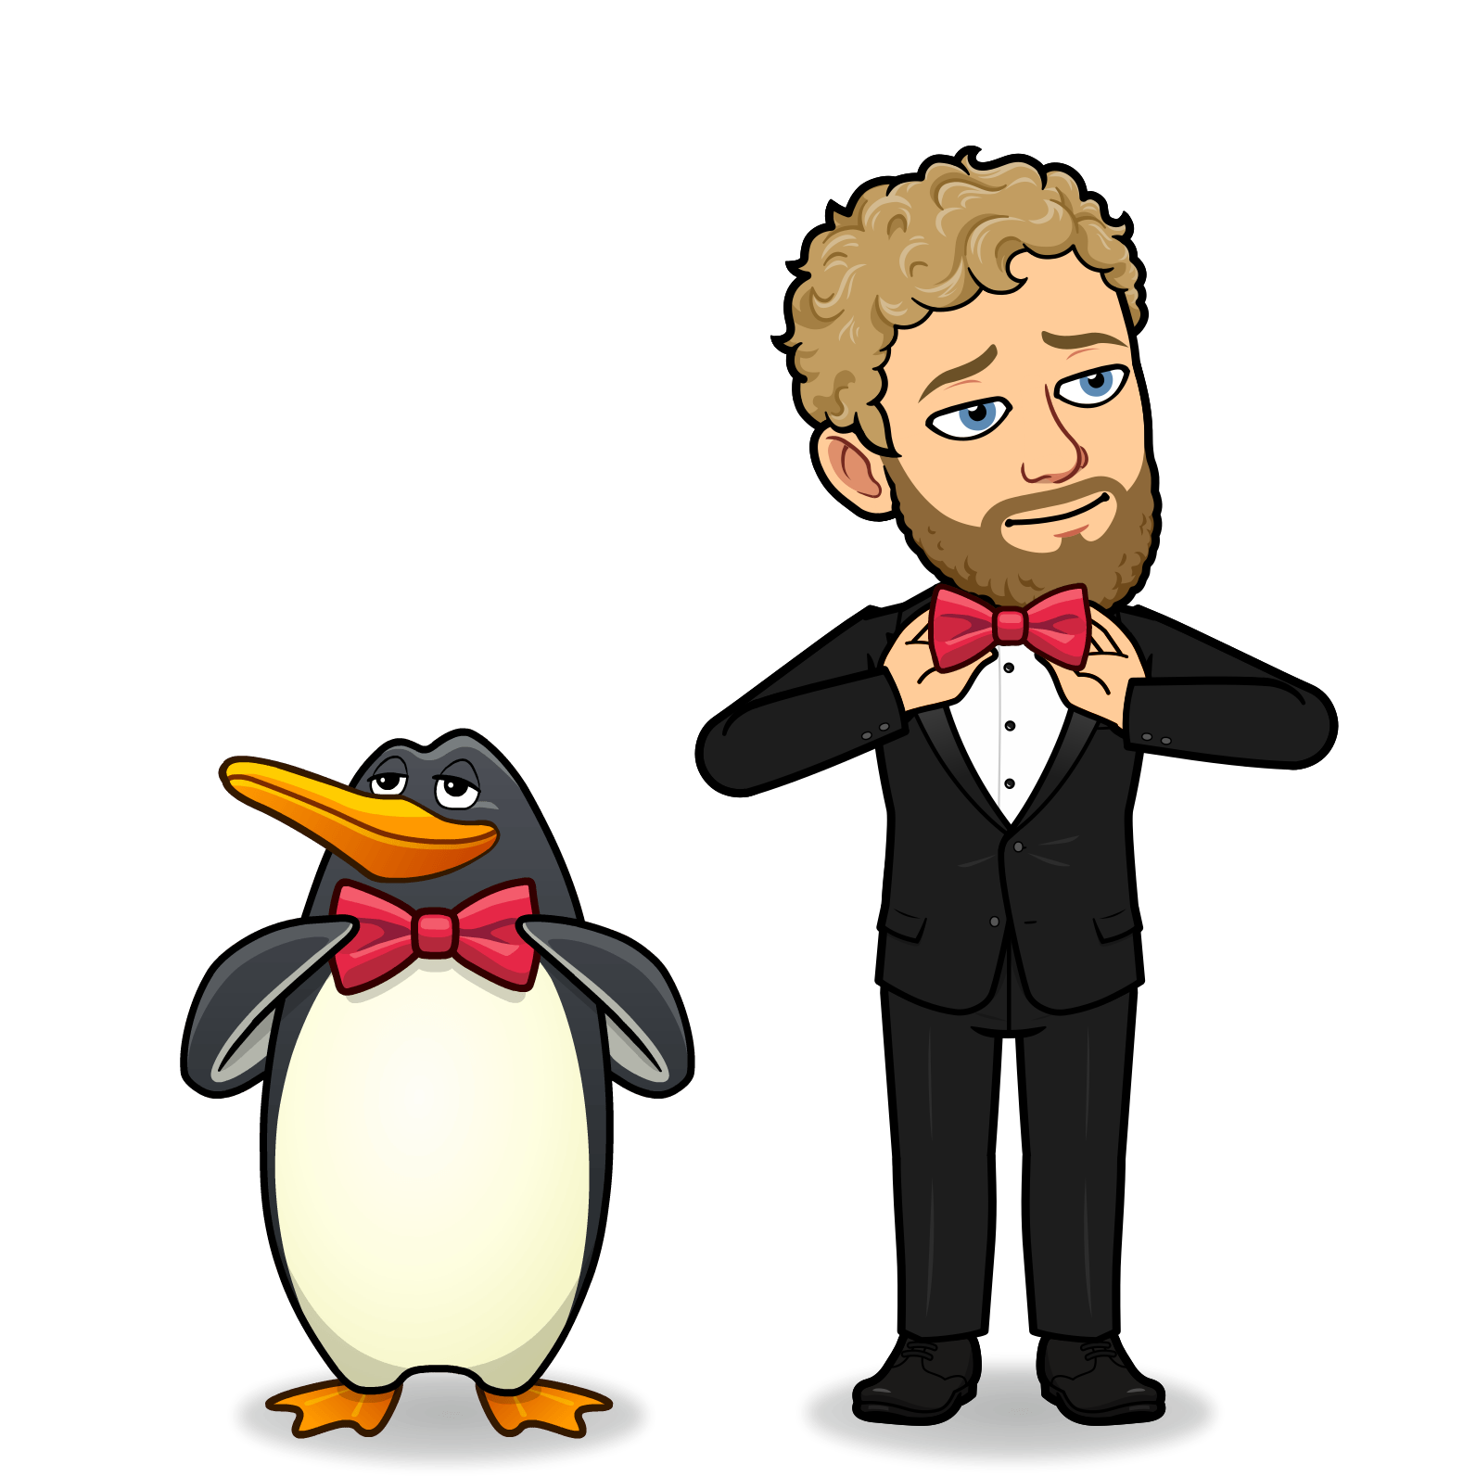
Mr. Warren made it on time for
the party.

Slide 15
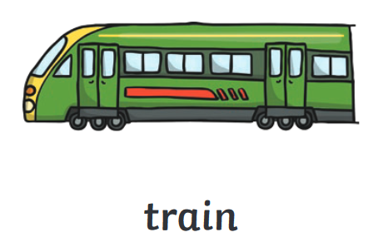
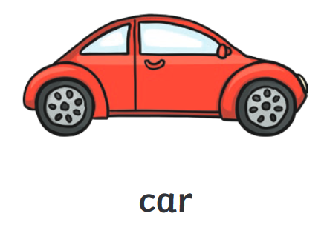
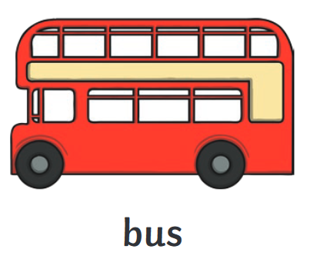
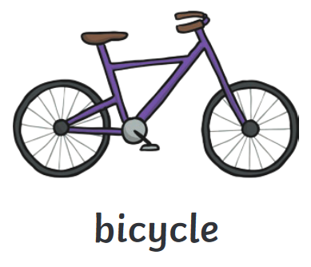
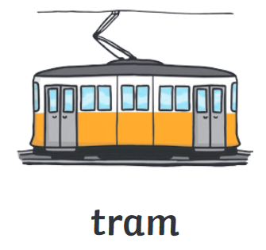
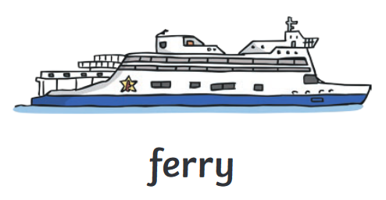

Slide 16
