Slide 1
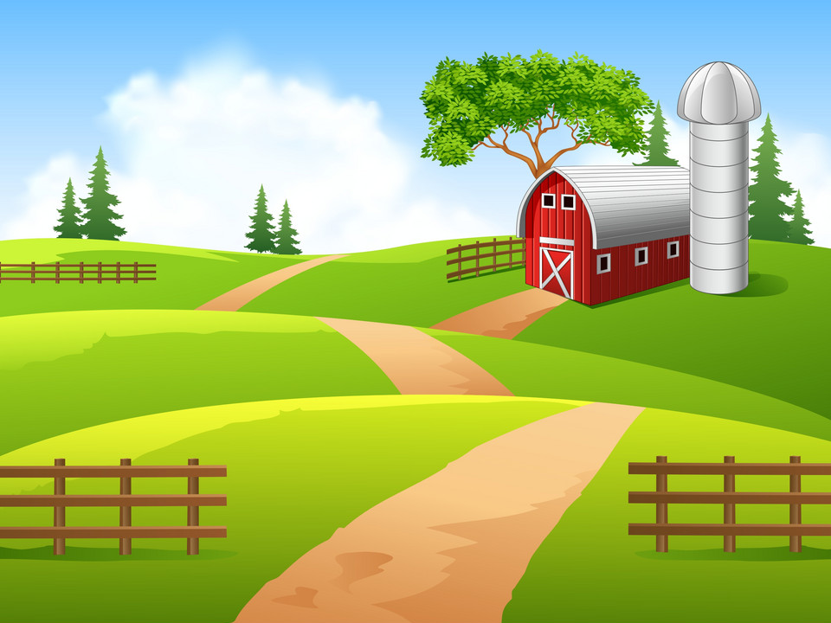
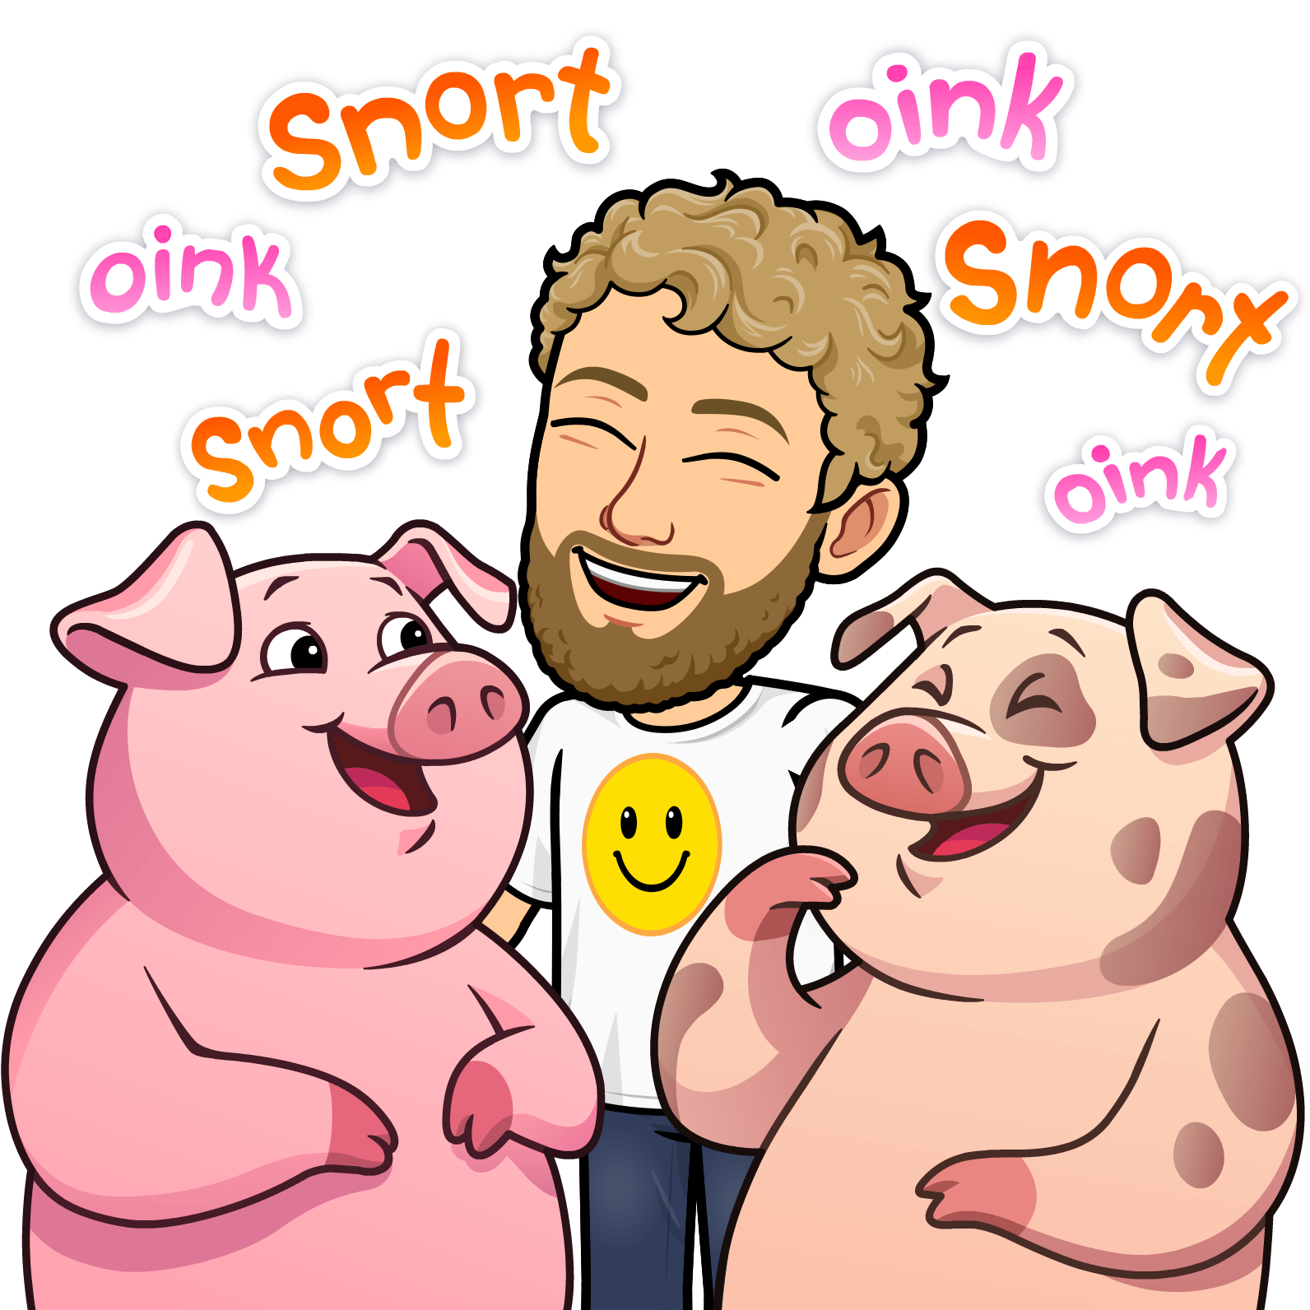
Fun With Farm Friends!
Mr. Warren’s

Slide 2
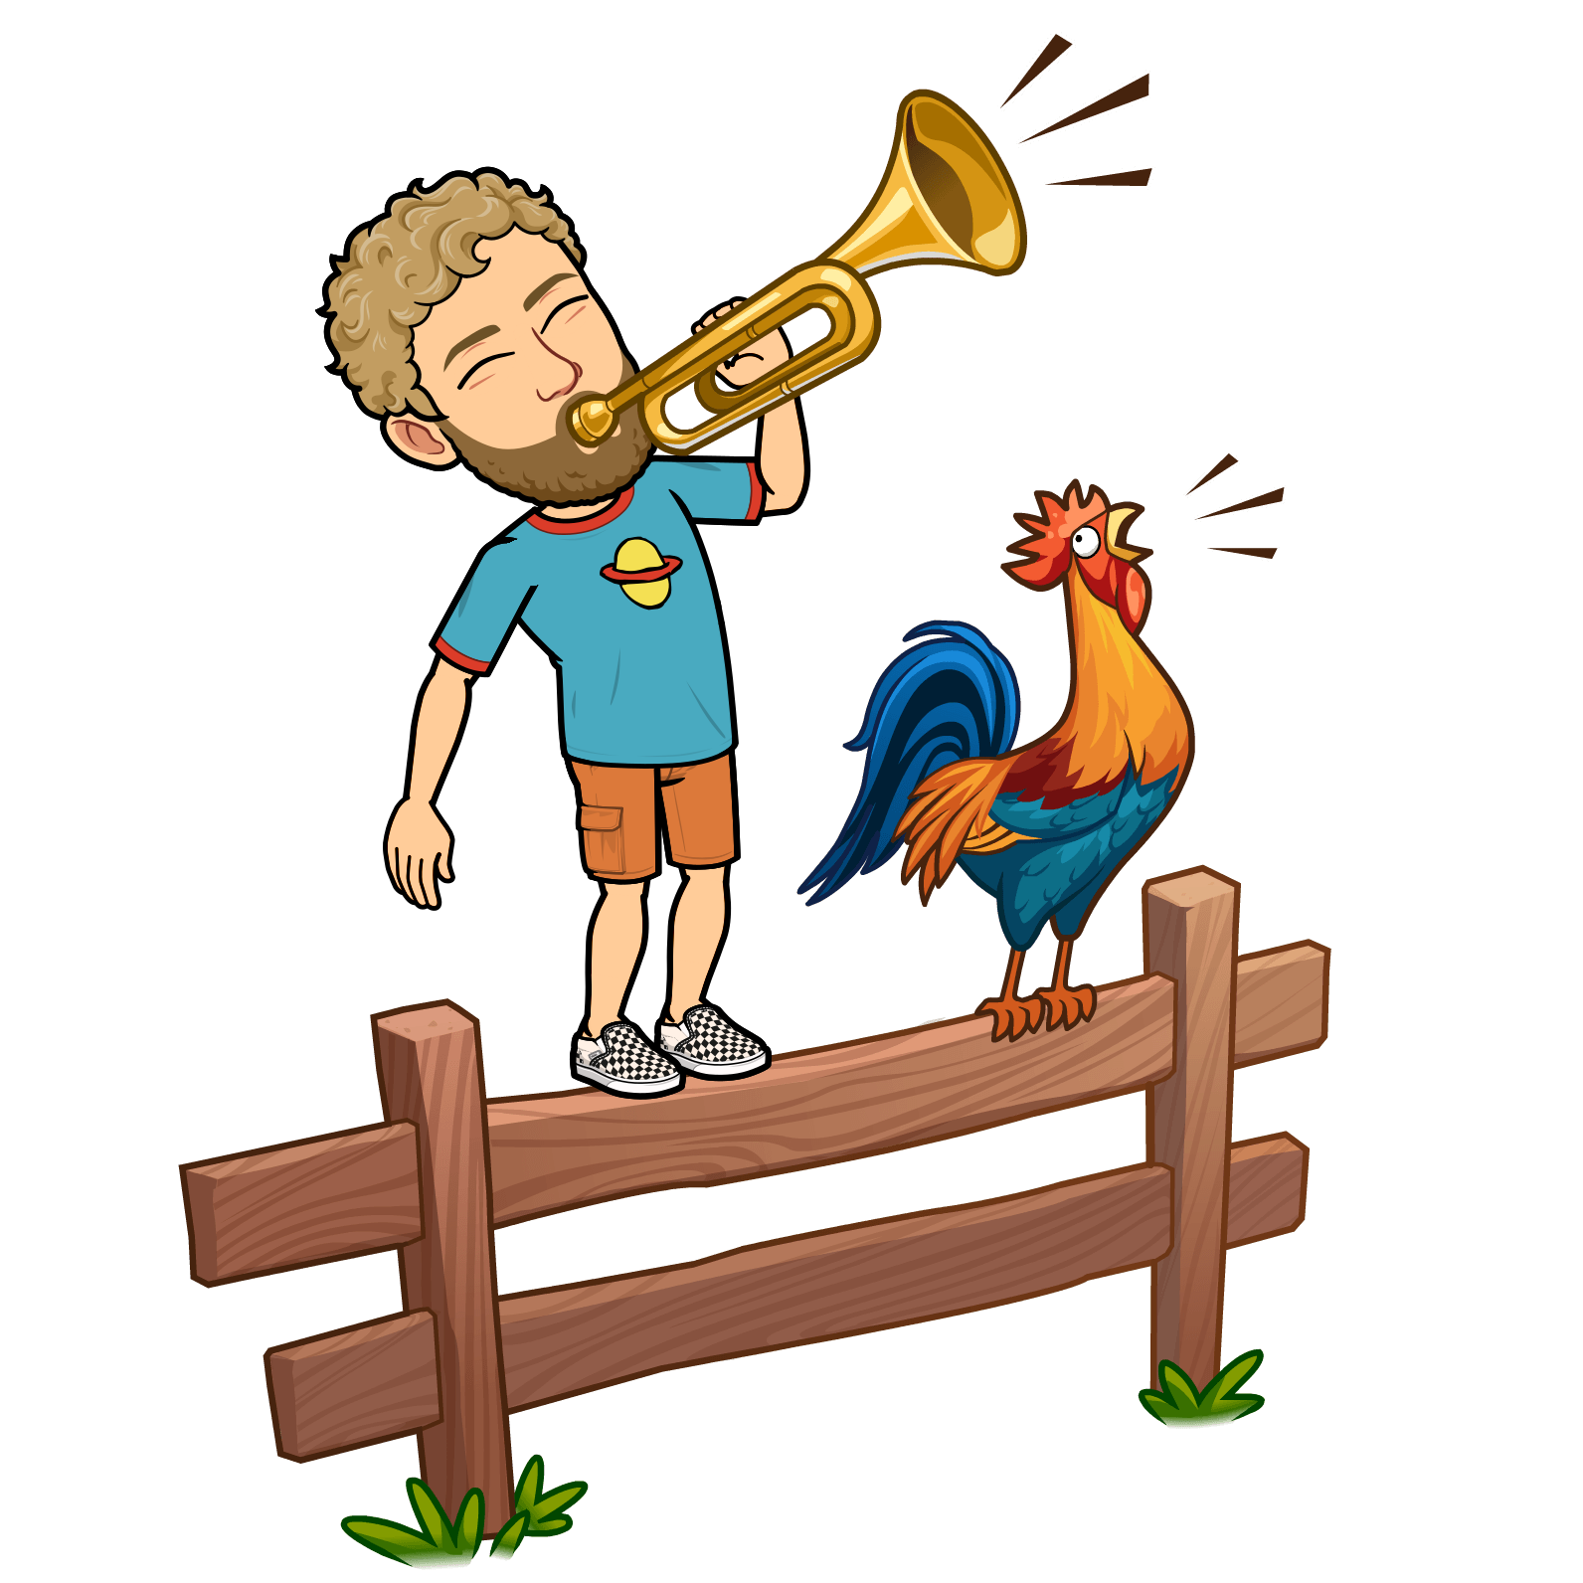
Mr. Warren likes to cock-a-doodle-do with a rooster.
Roosters like to wake everyone up in the morning by being super loud!

Slide 3
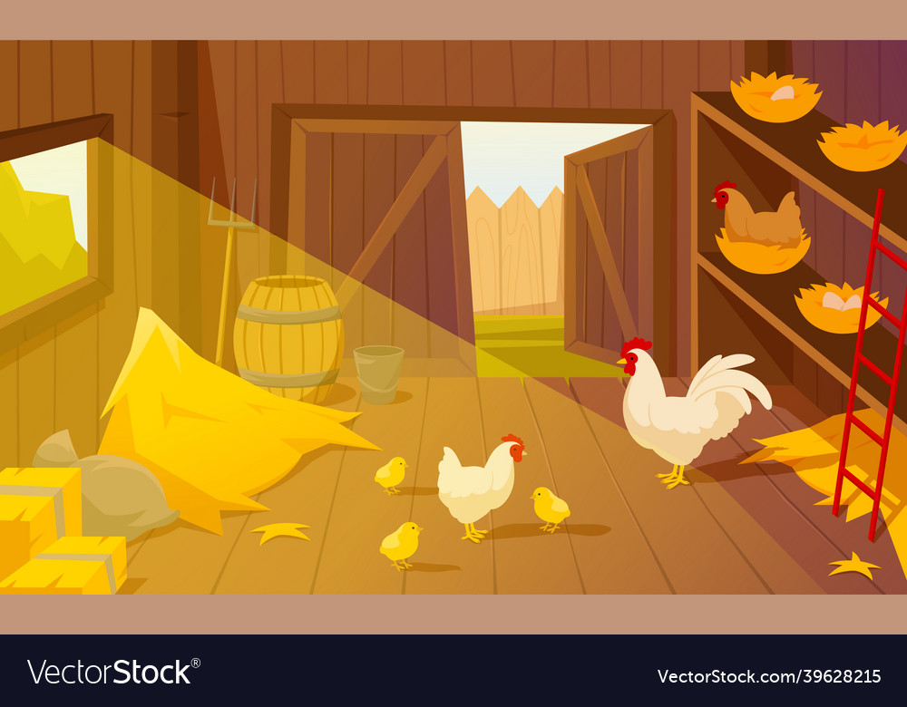
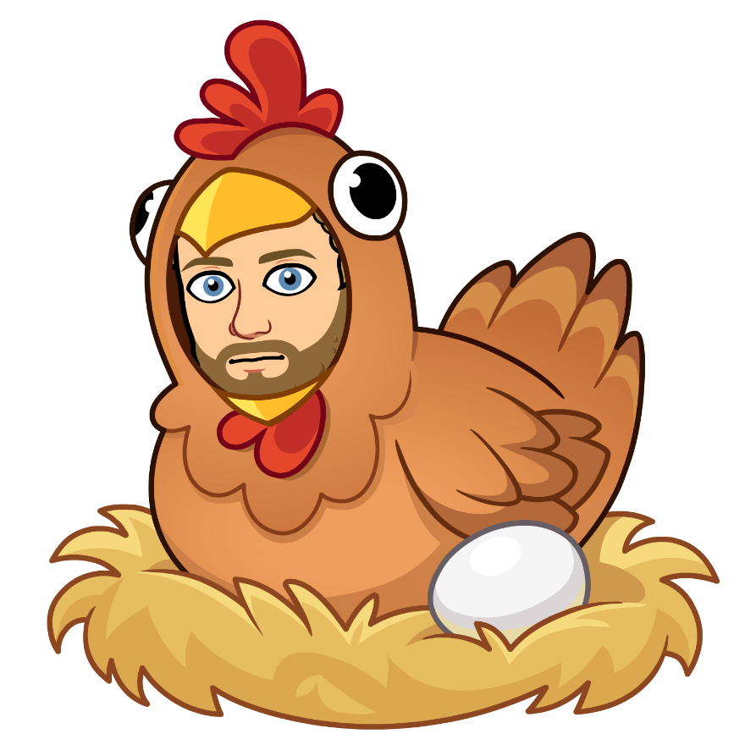
Mr. Warren likes to cluck with a hen.
Hens lay eggs to make baby chicks.

Slide 4
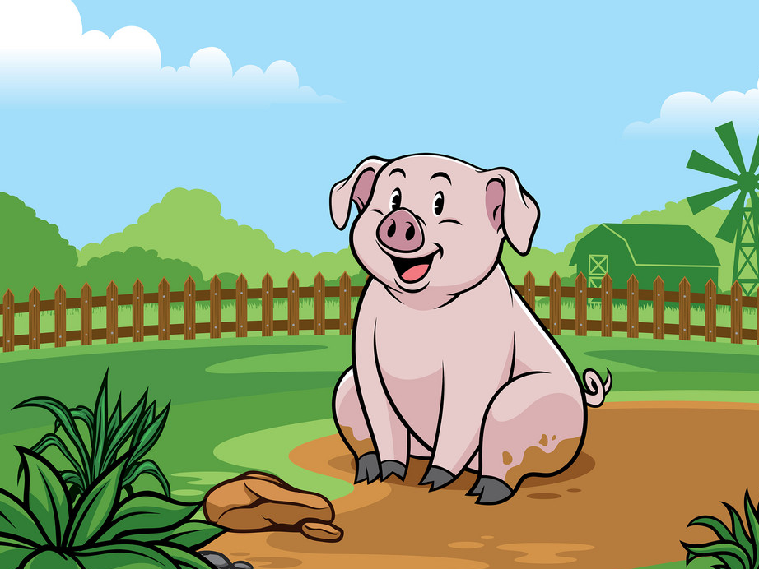
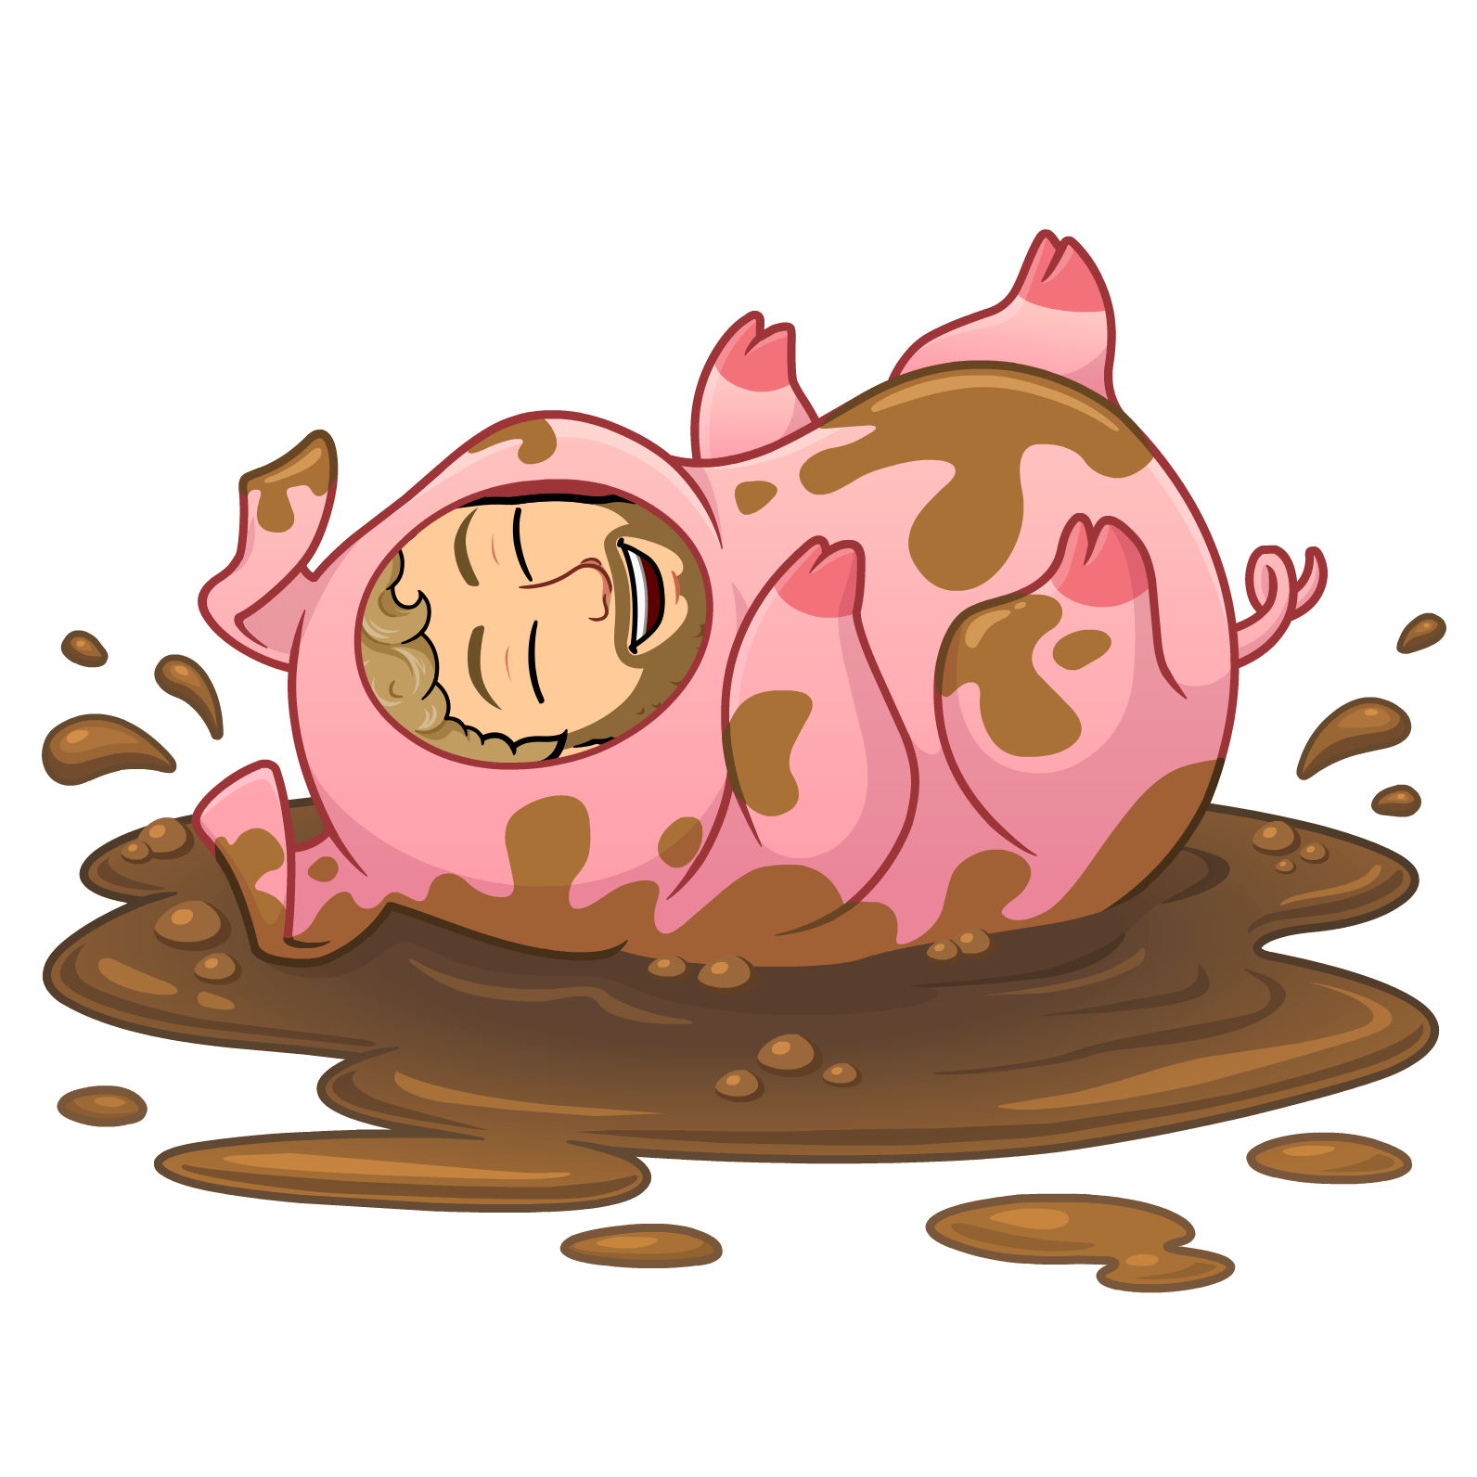
Mr. Warren likes to oink with a pig.
Pigs like to play in the mud all day.

Slide 5
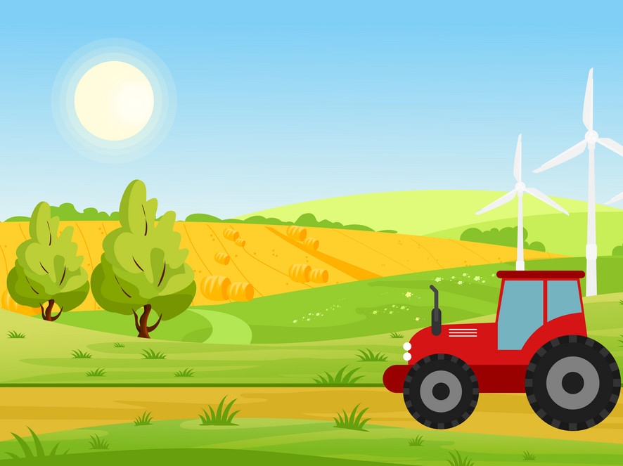
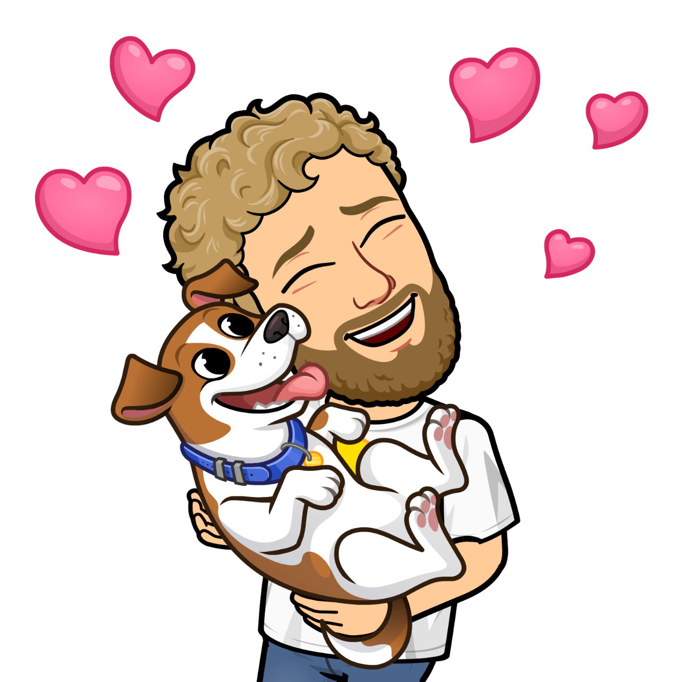
Mr. Warren likes to woof with a dog.
Dogs are always happy to give a lot of love!

Slide 6
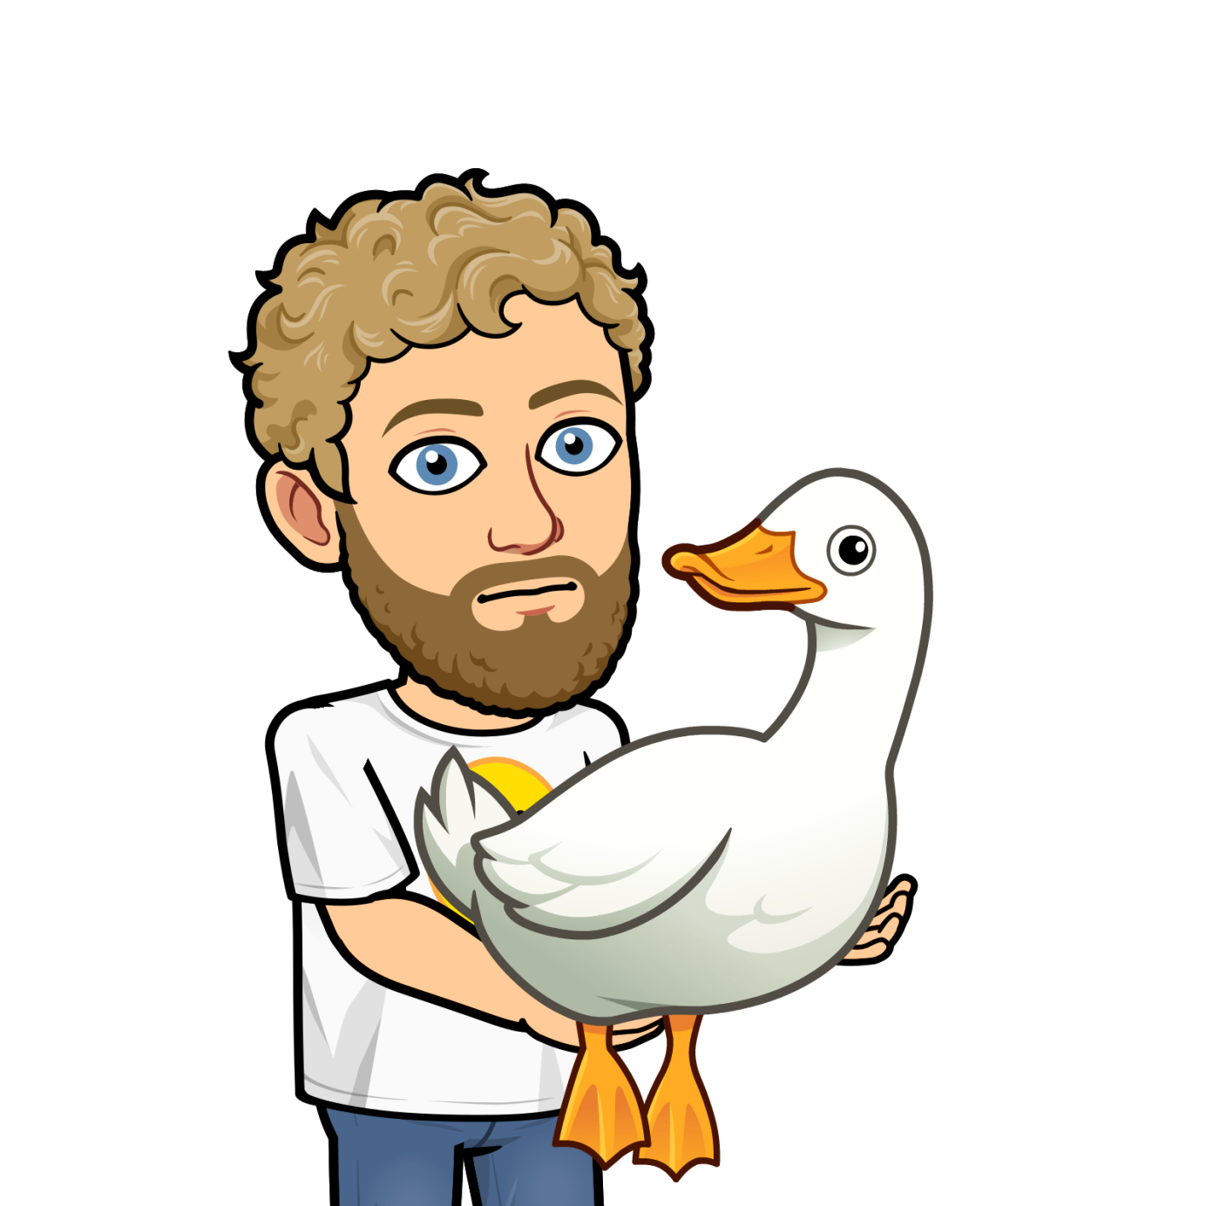
Mr. Warren likes to quack with a duck.
Ducks like to swim, fly and walk all over the farm.

Slide 7
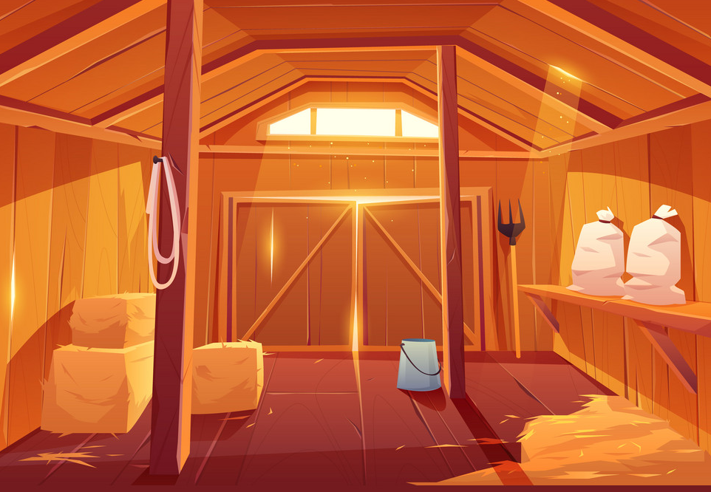
Mr. Warren likes to moo with a cow.
Cows like to sleep in a barn all night and give milk all day.

Slide 8
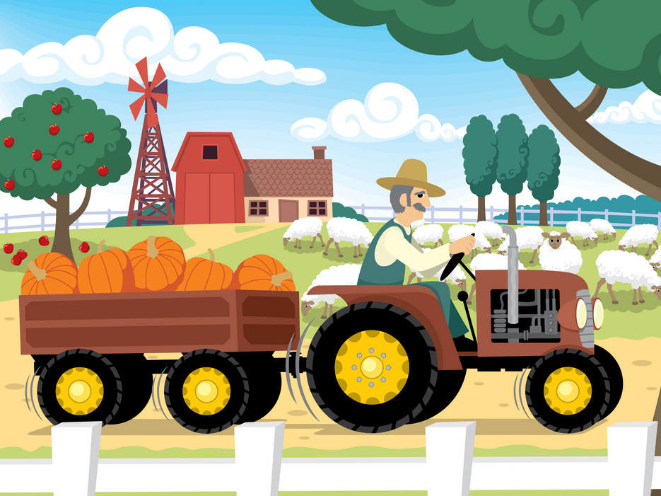
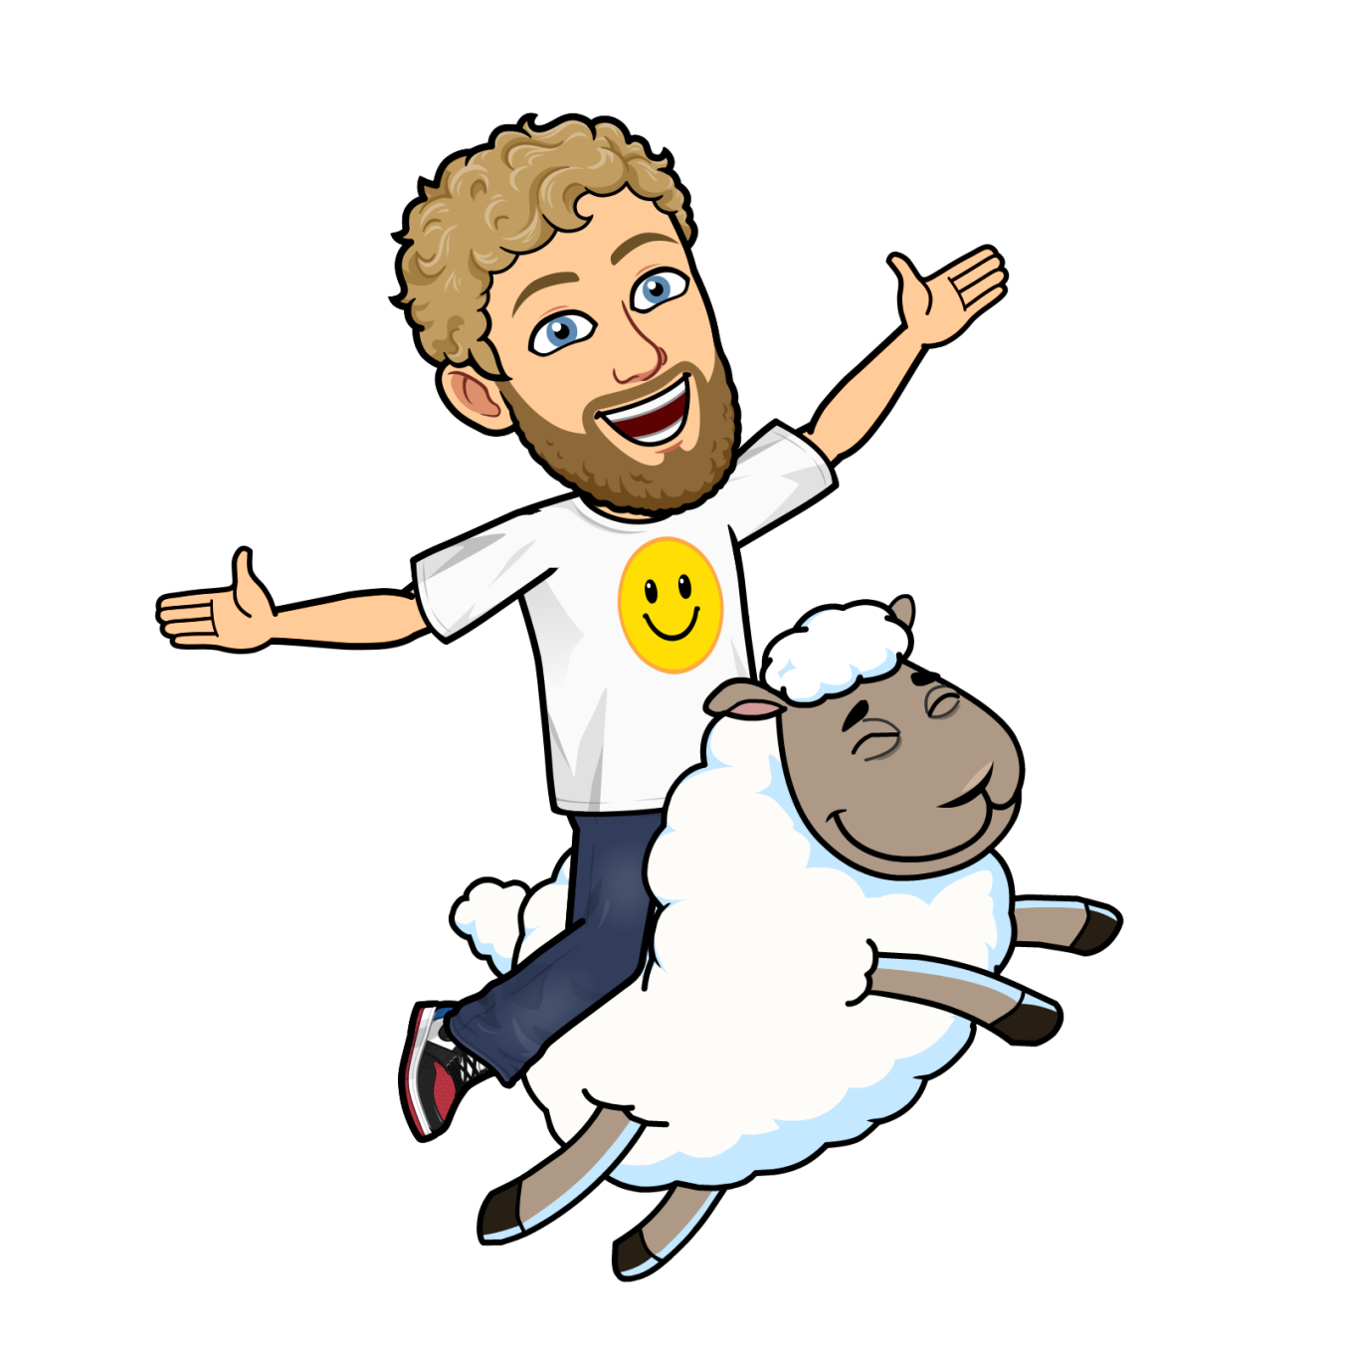
Mr. Warren likes to baa with a sheep.
Sheep are so fluffy and likes to graze on grass.

Slide 9
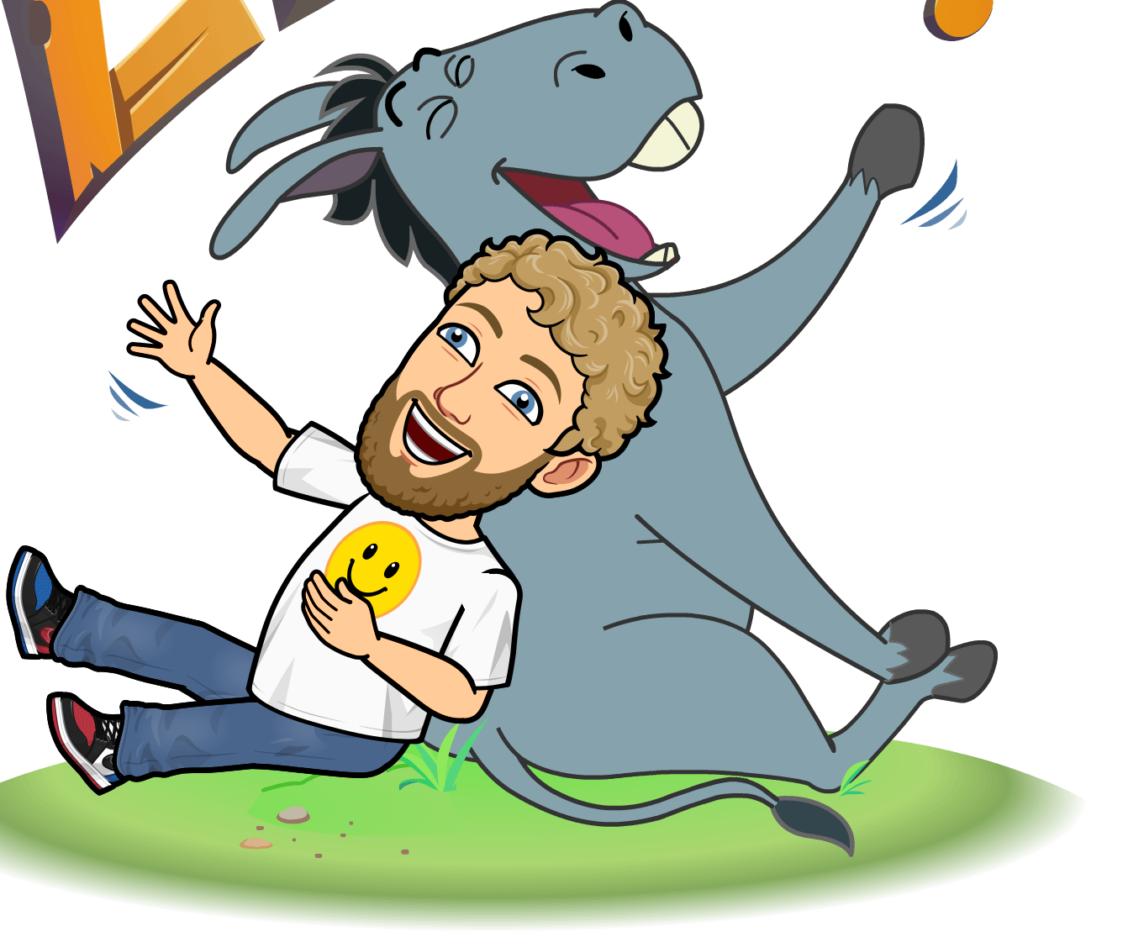
Mr. Warren likes to bray with a donkey.
Donkey’s have a very silly and loud sounding laugh.

Slide 10
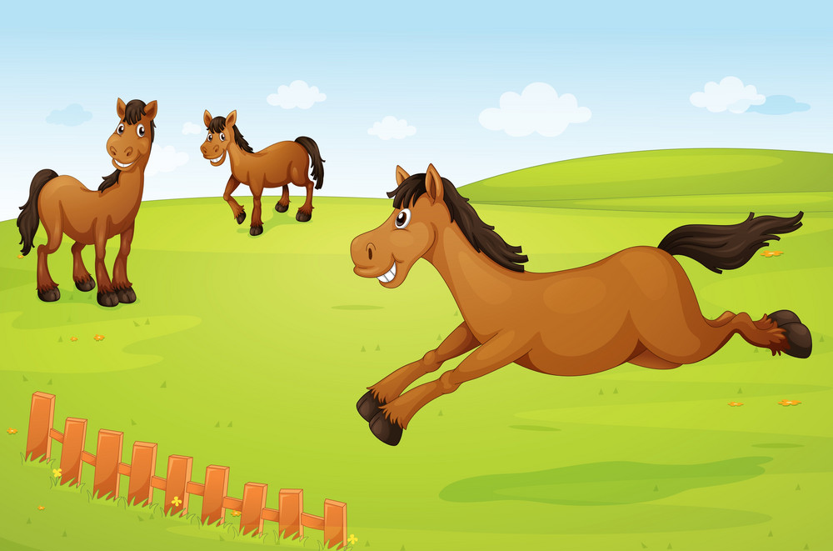
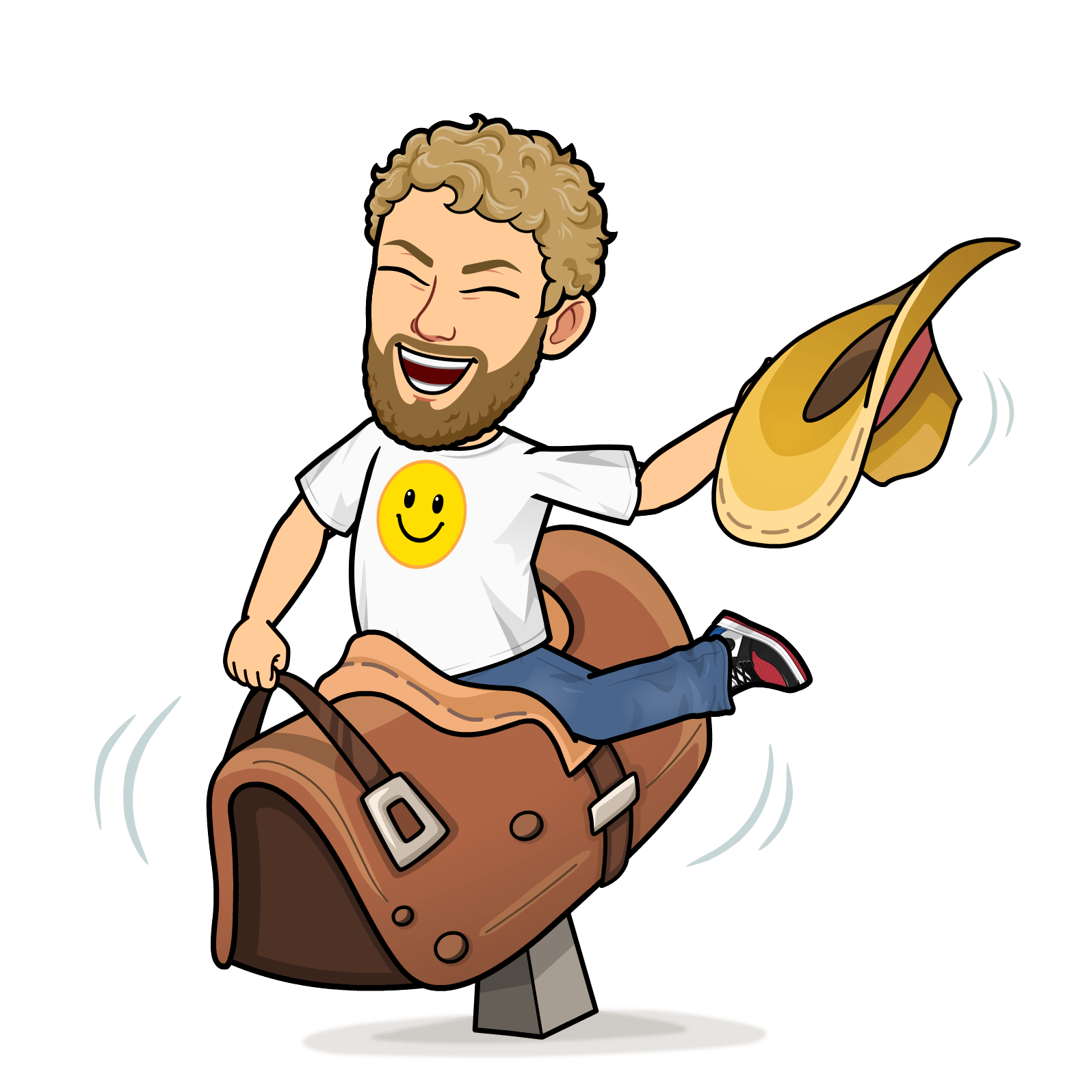
Mr. Warren likes to neigh with a horse.
Horses like to run very fast.

Slide 11
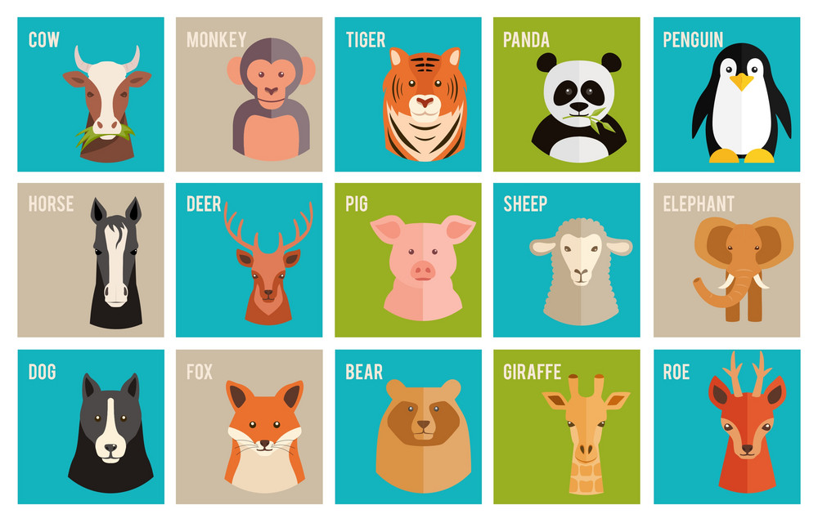
Which farm animals did Mr. Warren see?

Slide 12
