Slide 1
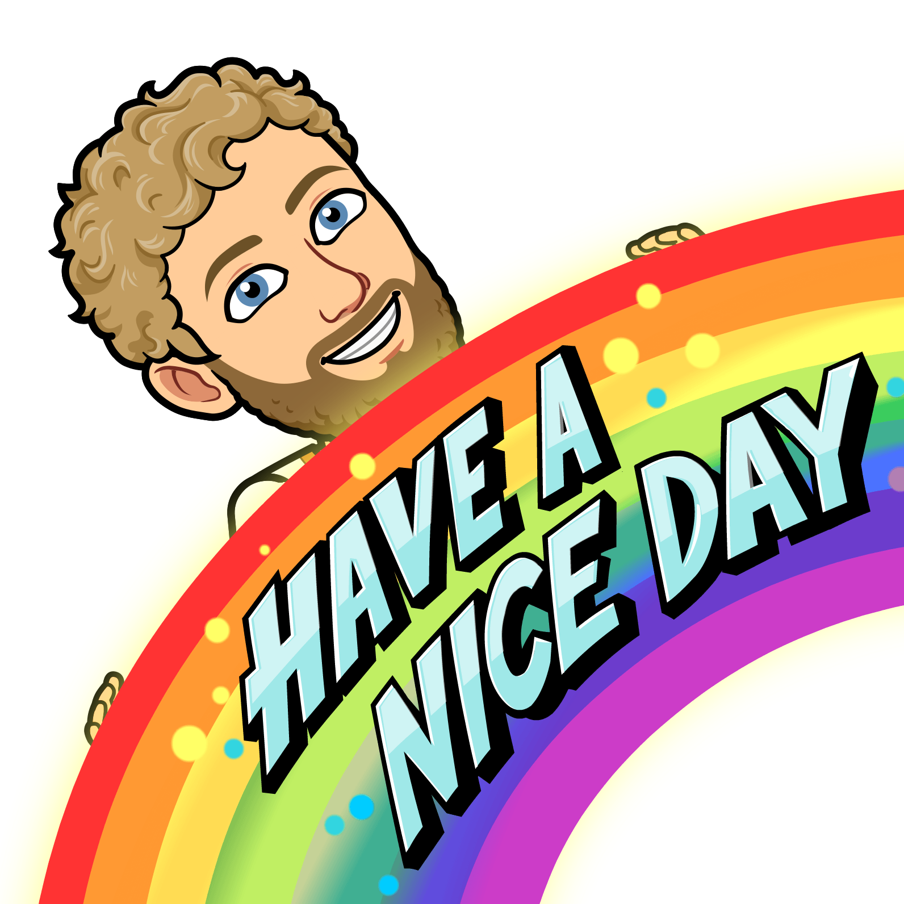

Slide 2
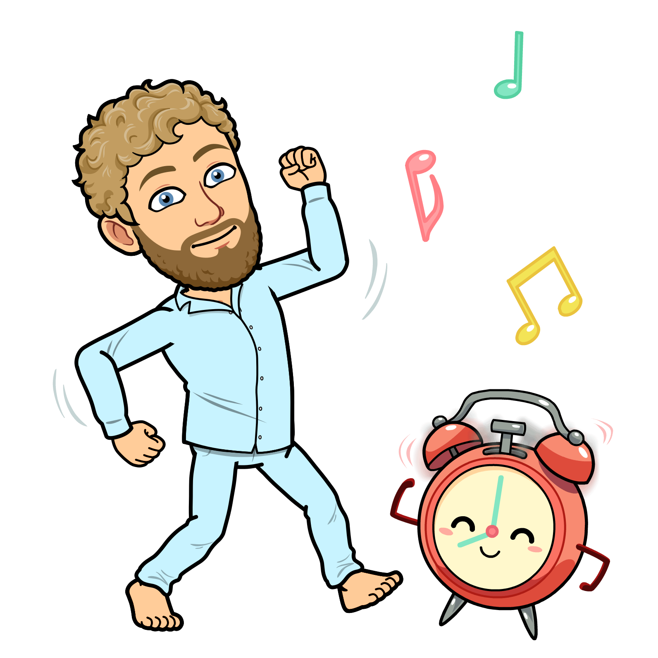
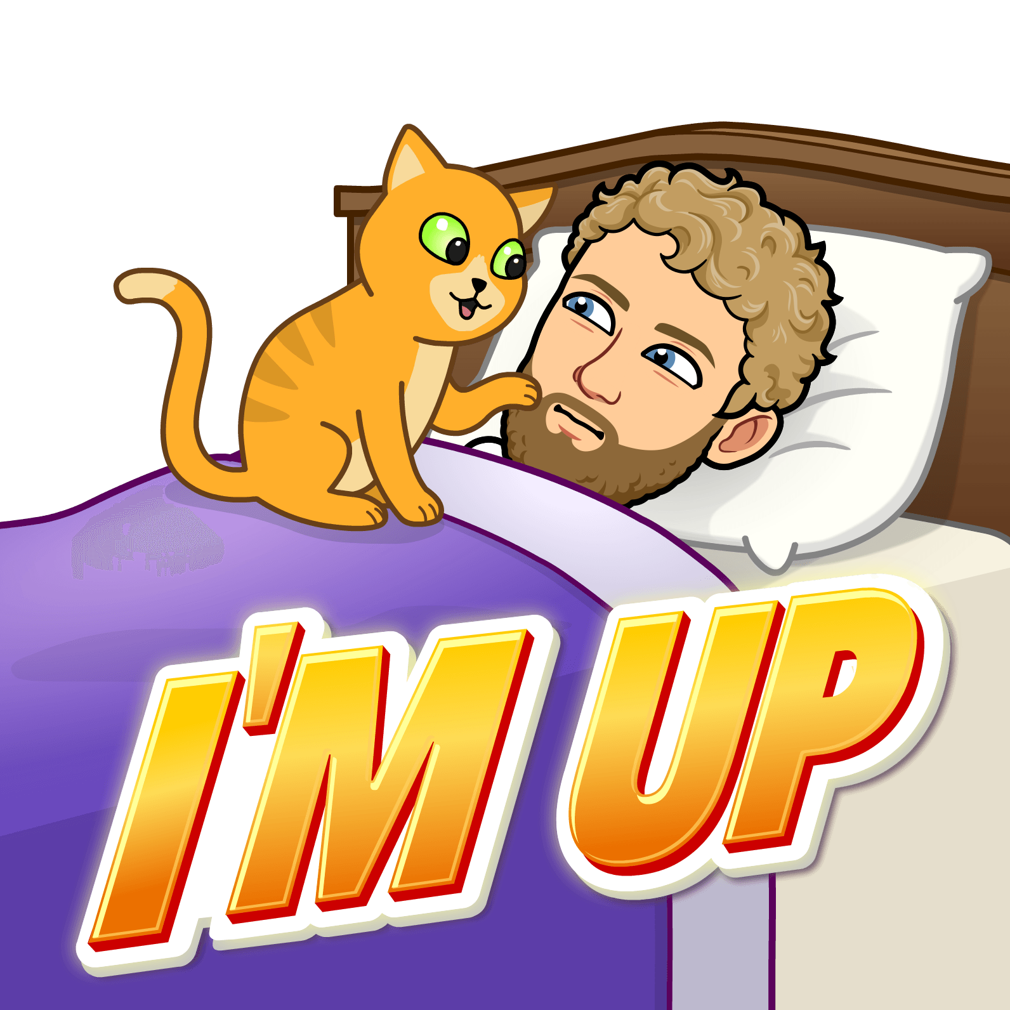
Every morning Mr. Warren’s cat wakes him
up bright and early.
Mr. Warren starts his day with some
movements and music,
dancing is his favorite.

Slide 3
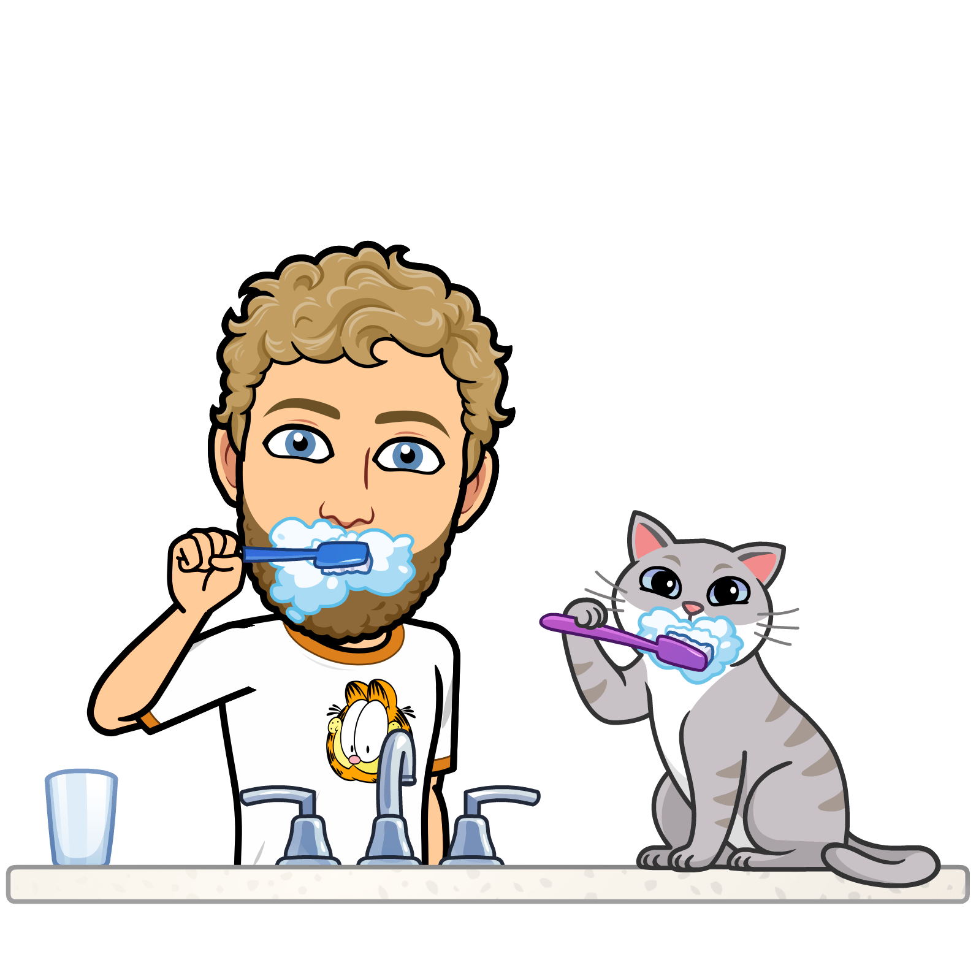
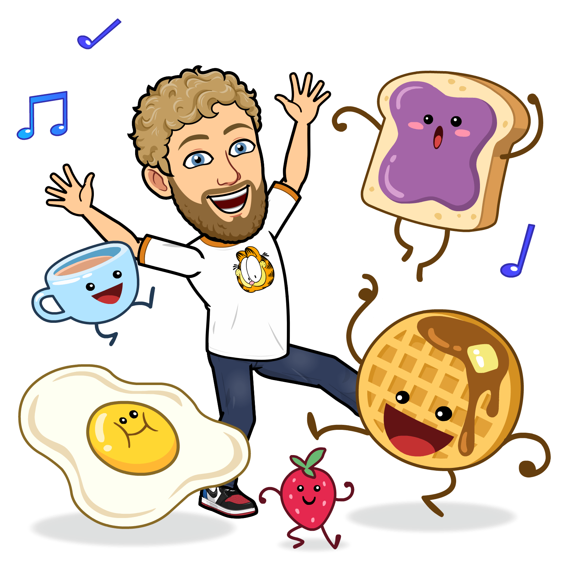
Mr. Warren’s favorite part of the day
is having a yummy breakfast!
“It is important to brush your teeth
every morning” says Mr. Warren.

Slide 4
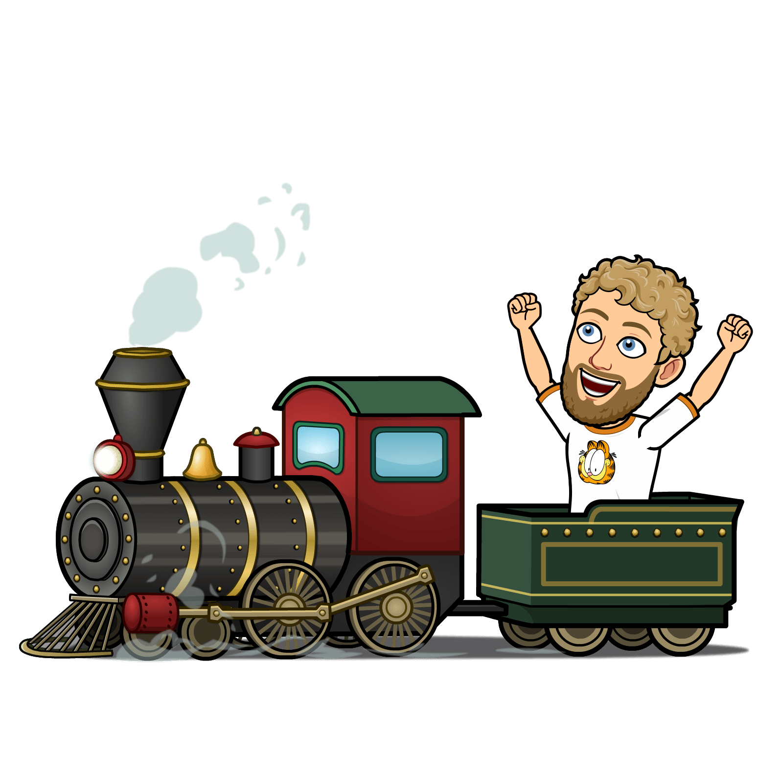
Mr. Warren makes his way to work.
He enjoys taking the train!
Mr. Warren enjoys doing his work well.
He is a happy worker.

Slide 5
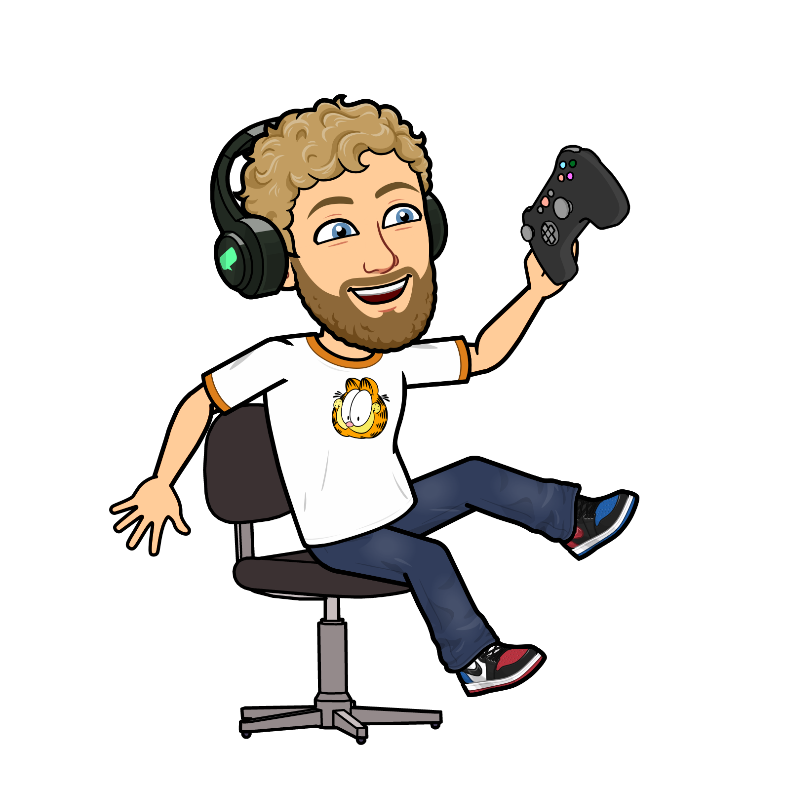
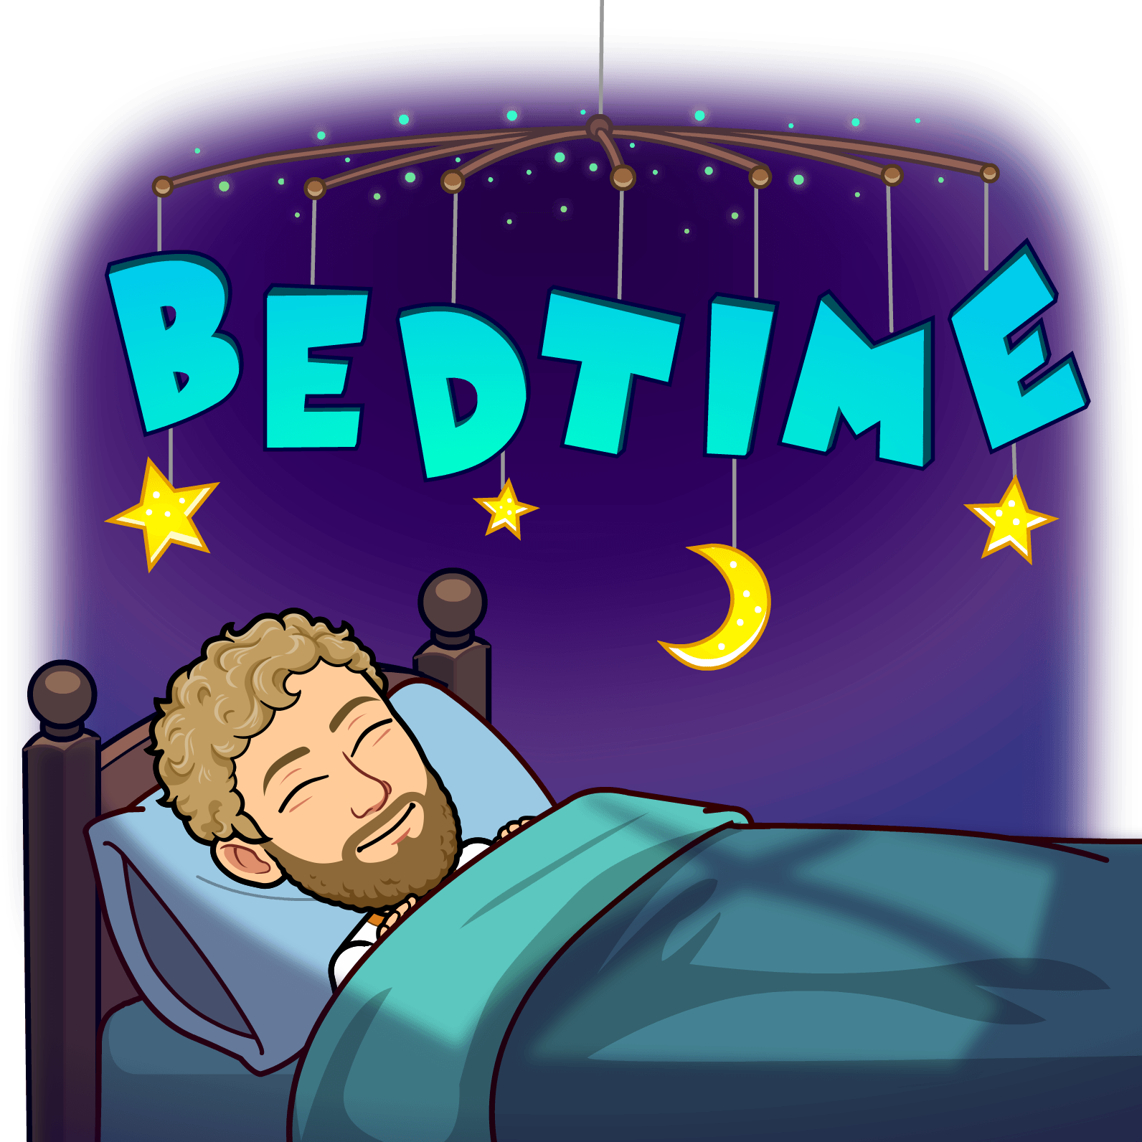
After a long day Mr. Warren goes to bed
and sleeps comfy in his bed.
Mr. Warren loves to play games.
“This makes me happy” says Mr. Warren.

