Slide 1
Let’s
talk
about
the
weather!

Slide 2
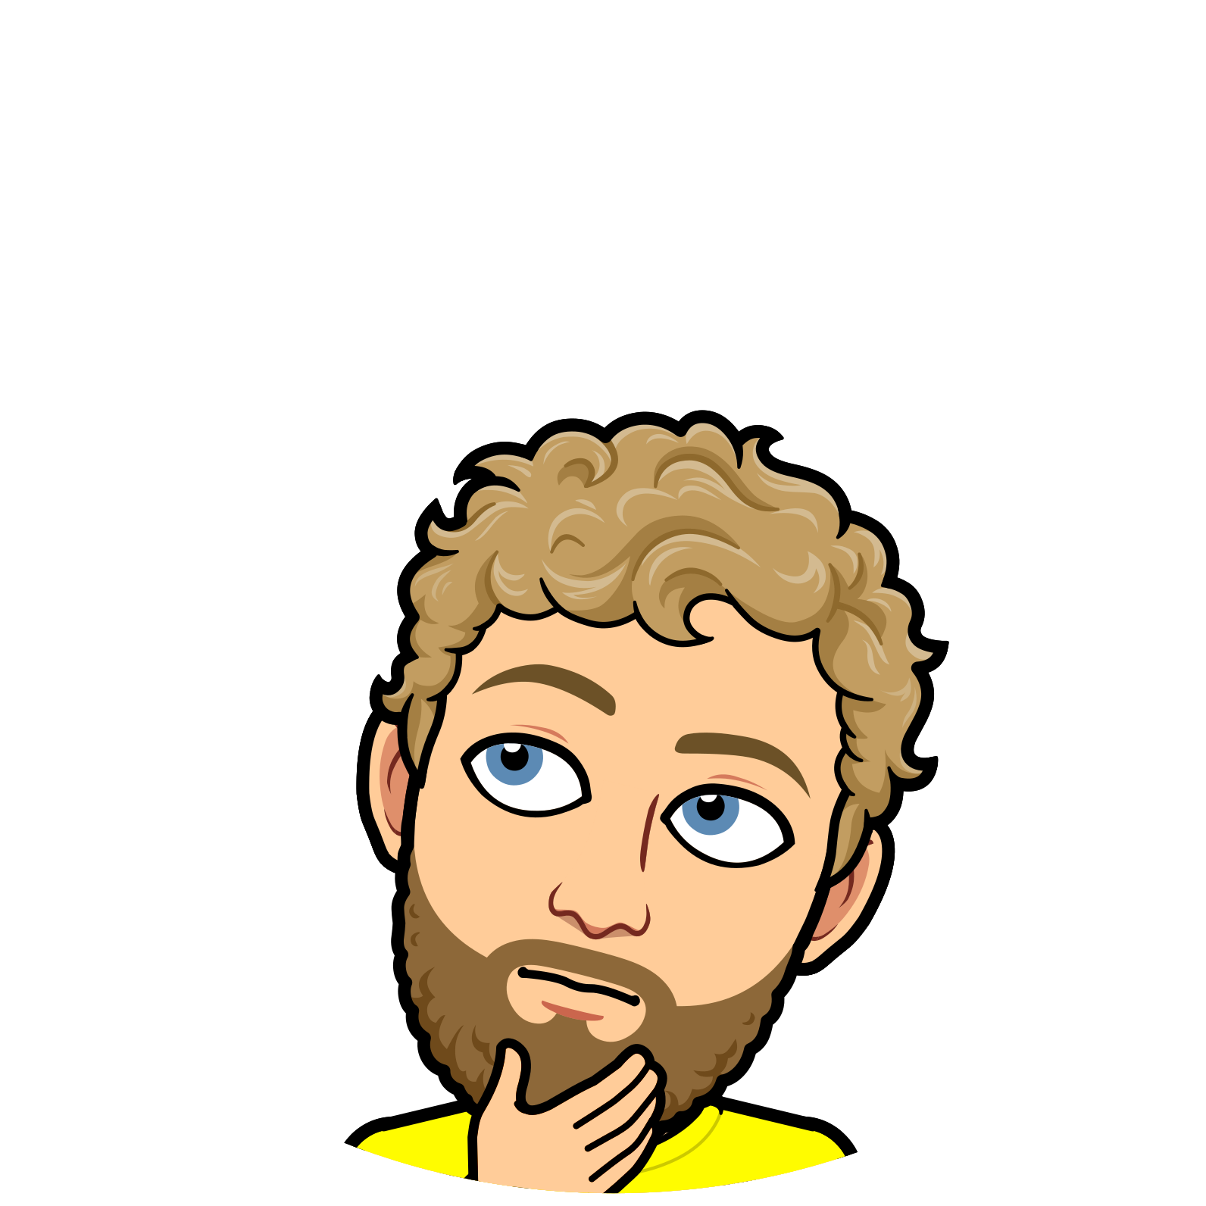
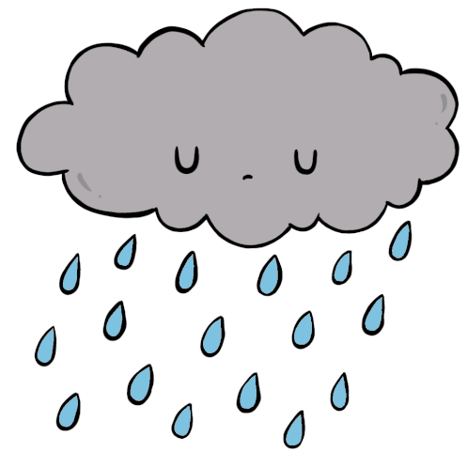
What is the
weather like
today?
rainy
cloudy
windy
sunny
snowy

Slide 3
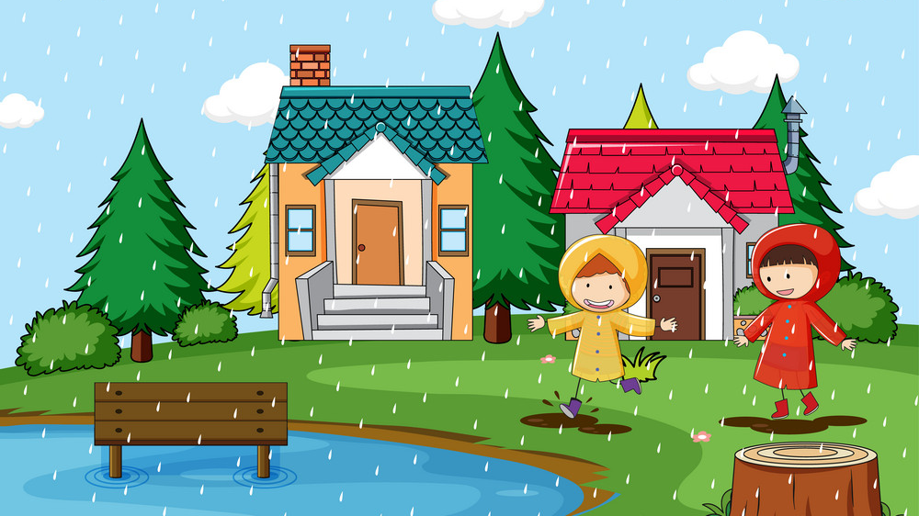
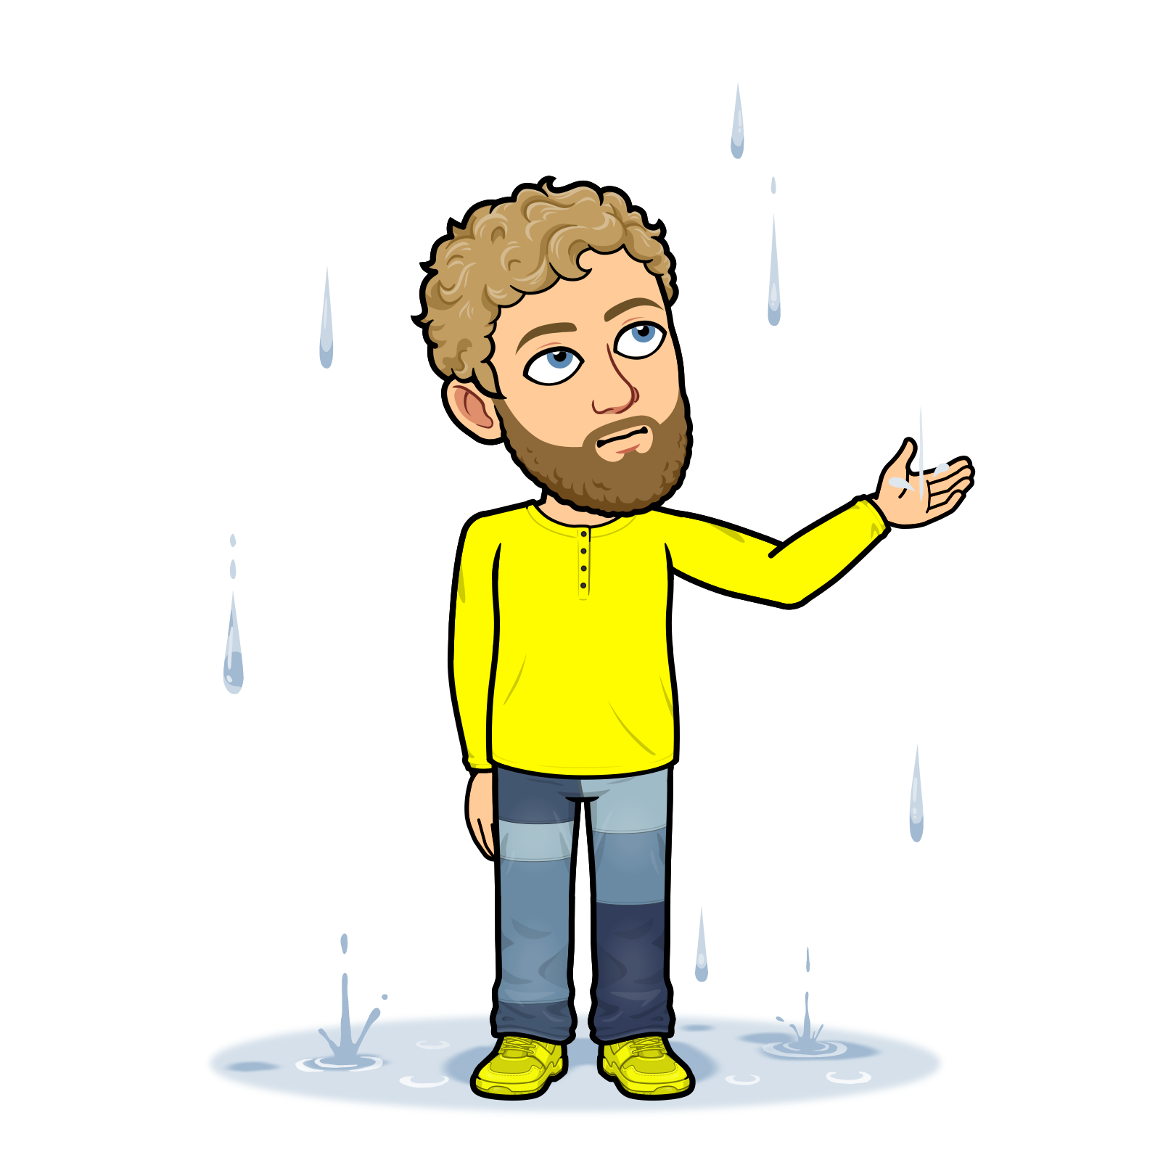
NEXT
rainy
cloudy
windy
sunny
snowy

Slide 4
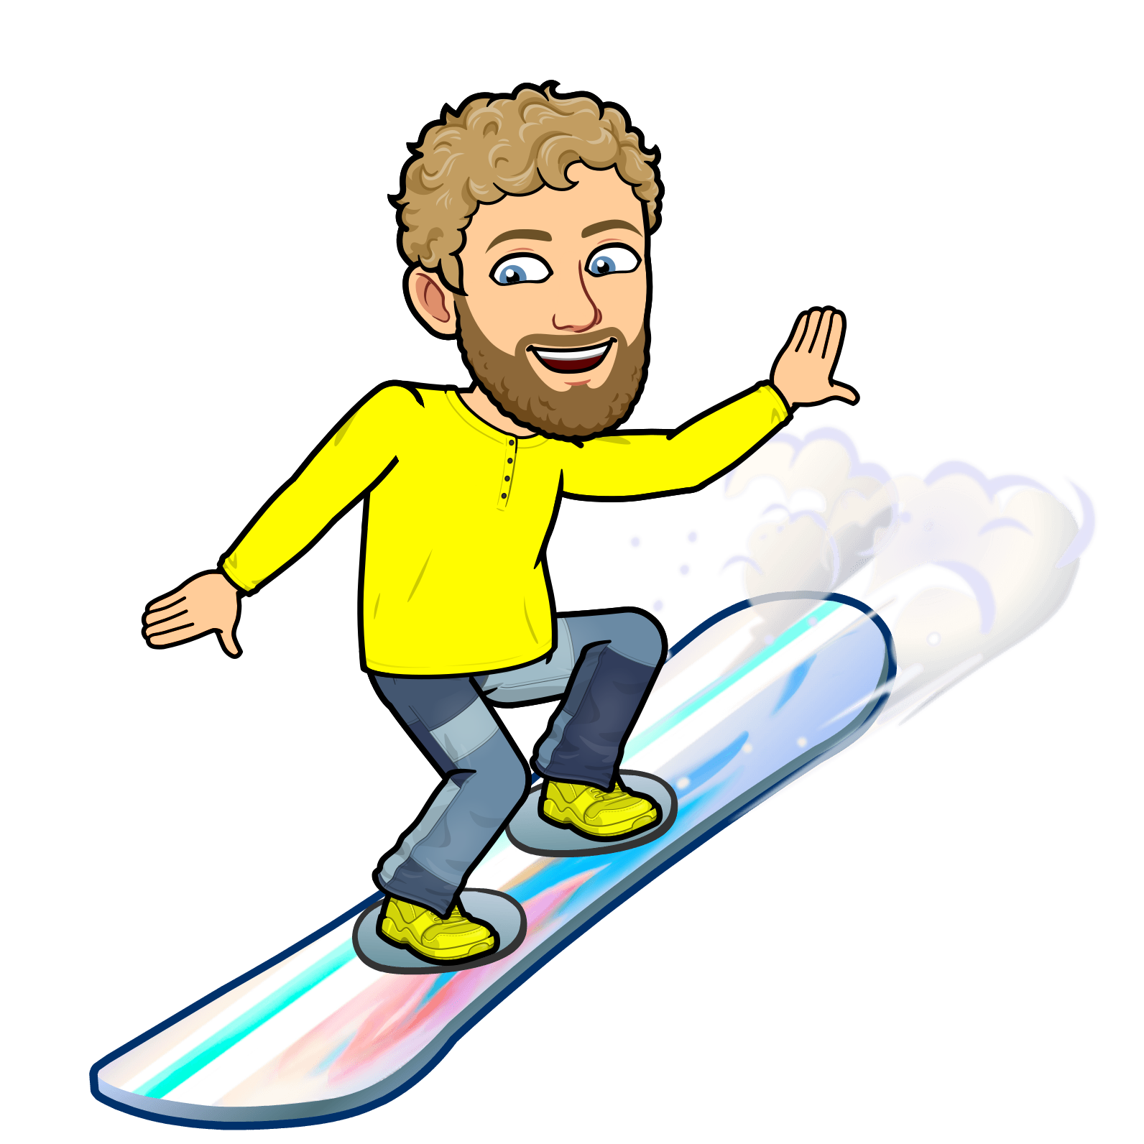
NEXT
rainy
cloudy
windy
sunny
snowy

Slide 5
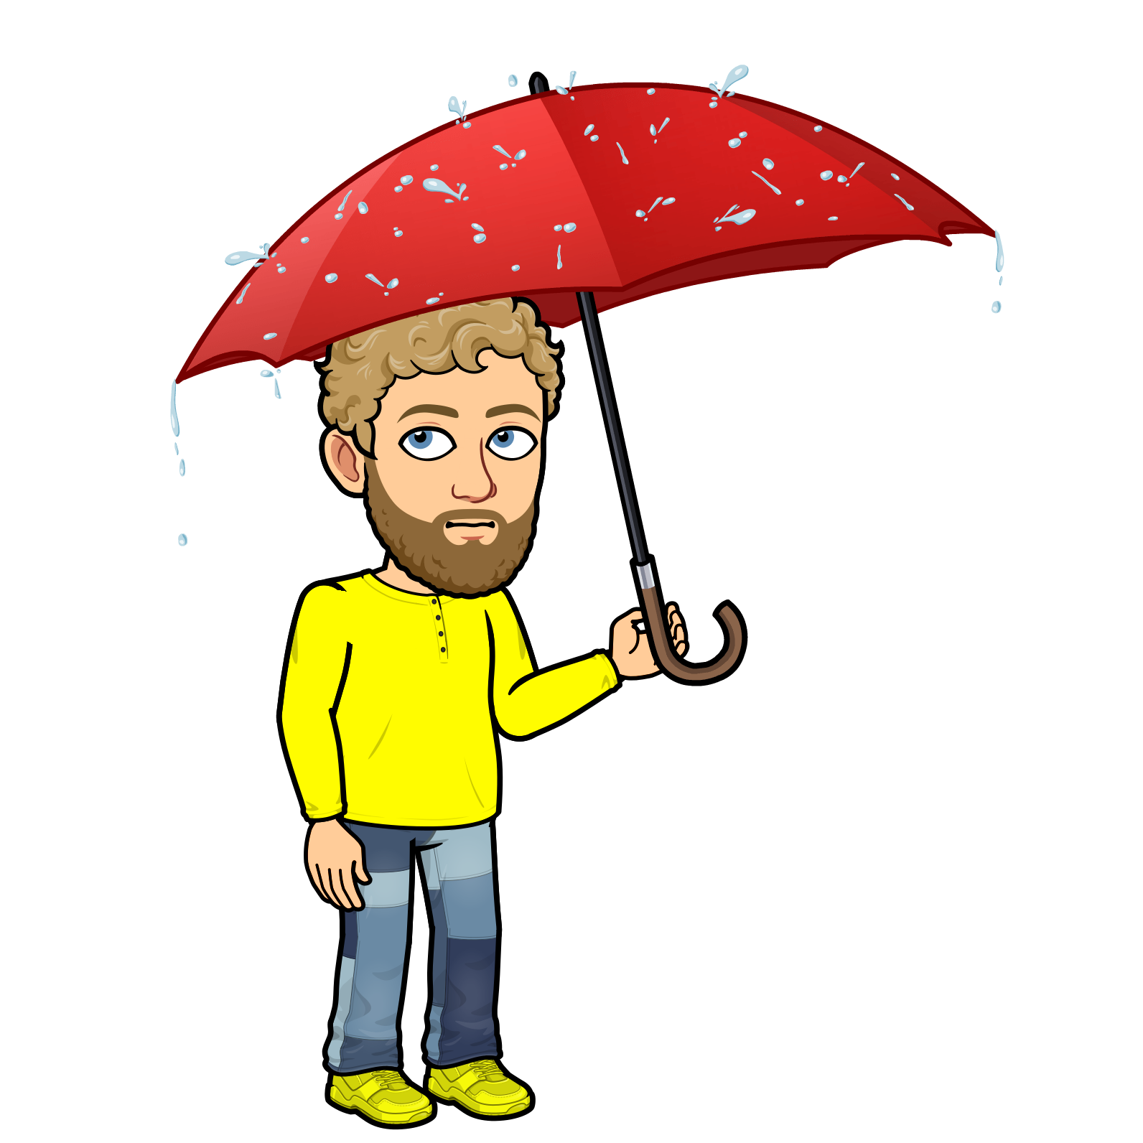
NEXT
rainy
cloudy
windy
sunny
snowy

Slide 6
NEXT
rainy
cloudy
windy
sunny
snowy

Slide 7
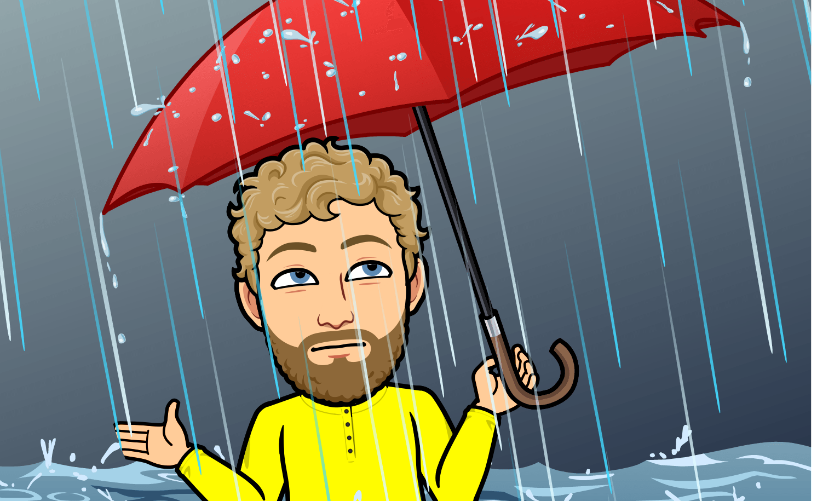
NEXT
rainy
cloudy
windy
sunny
snowy

Slide 8
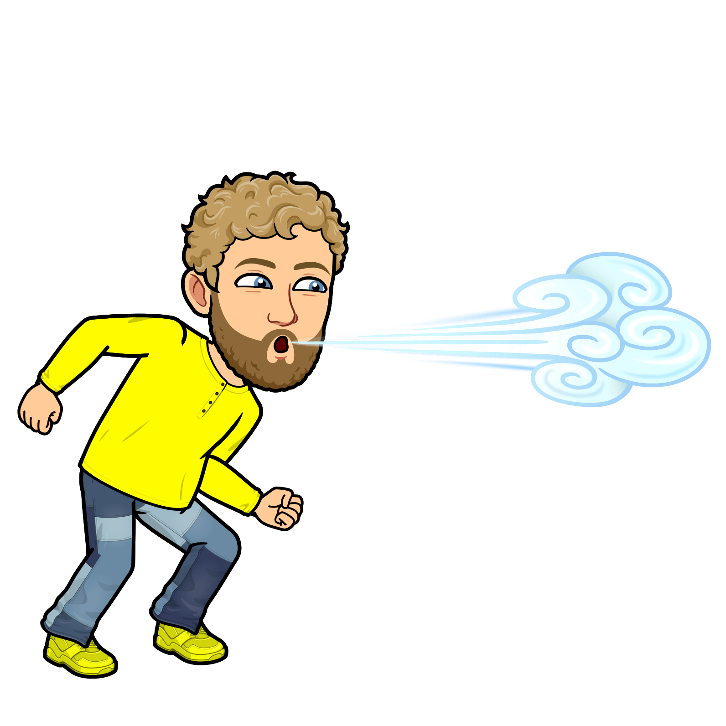
NEXT
rainy
cloudy
windy
sunny
snowy

Slide 9
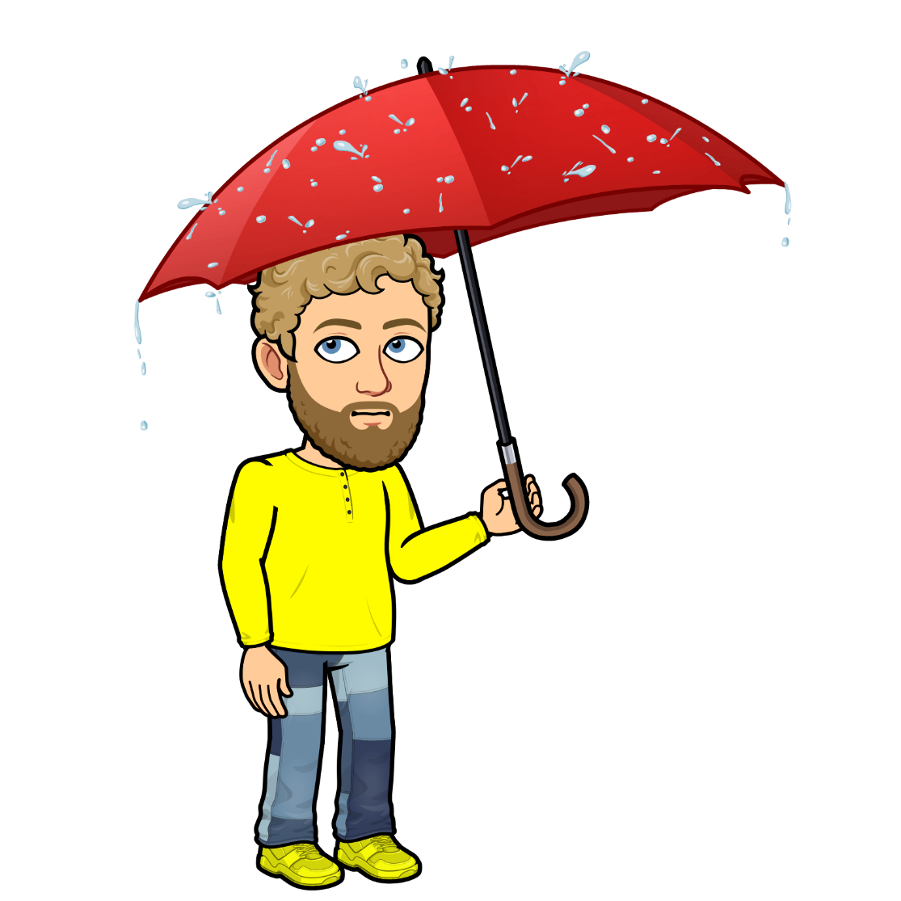
NEXT
rainy
cloudy
windy
sunny
snowy

Slide 10
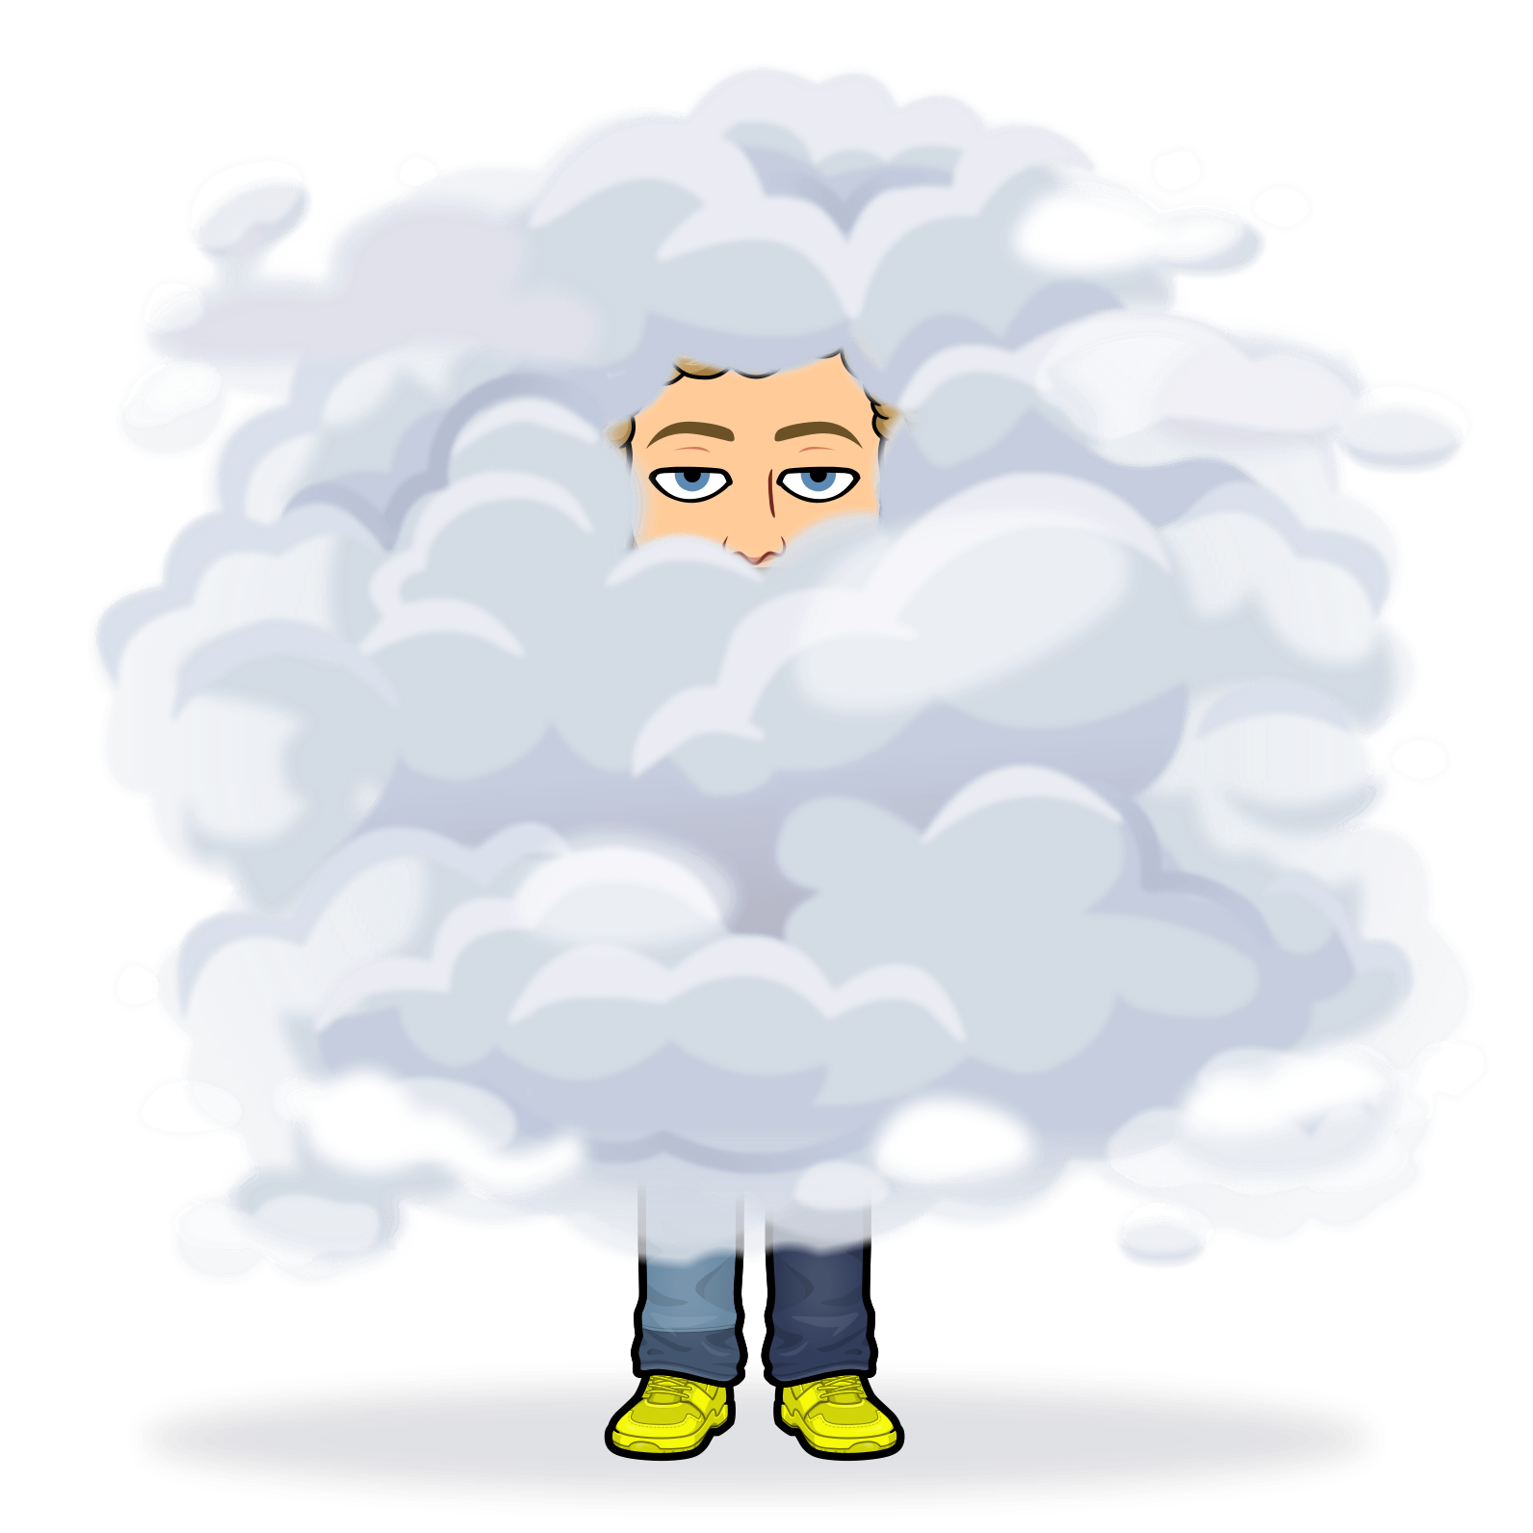
NEXT
rainy
cloudy
windy
sunny
snowy

Slide 11
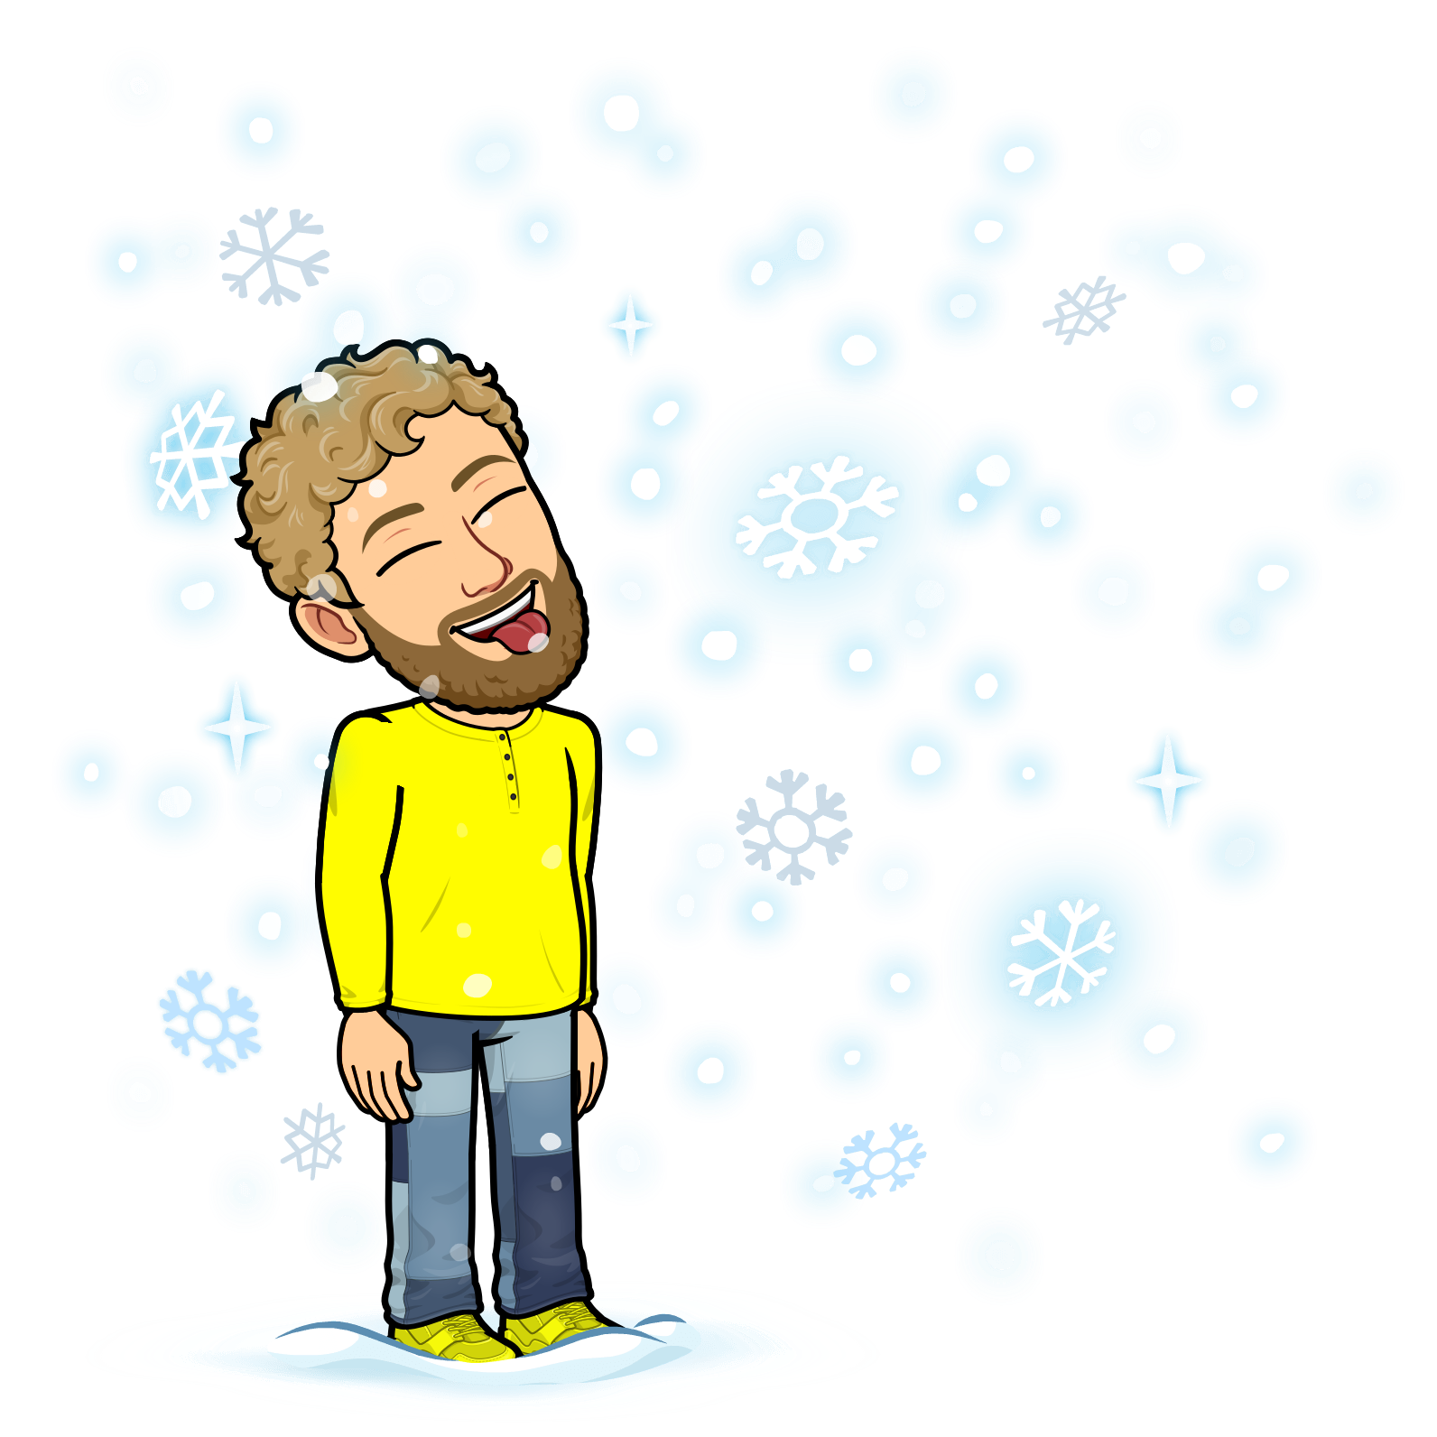
NEXT
rainy
cloudy
windy
sunny
snowy

Slide 12
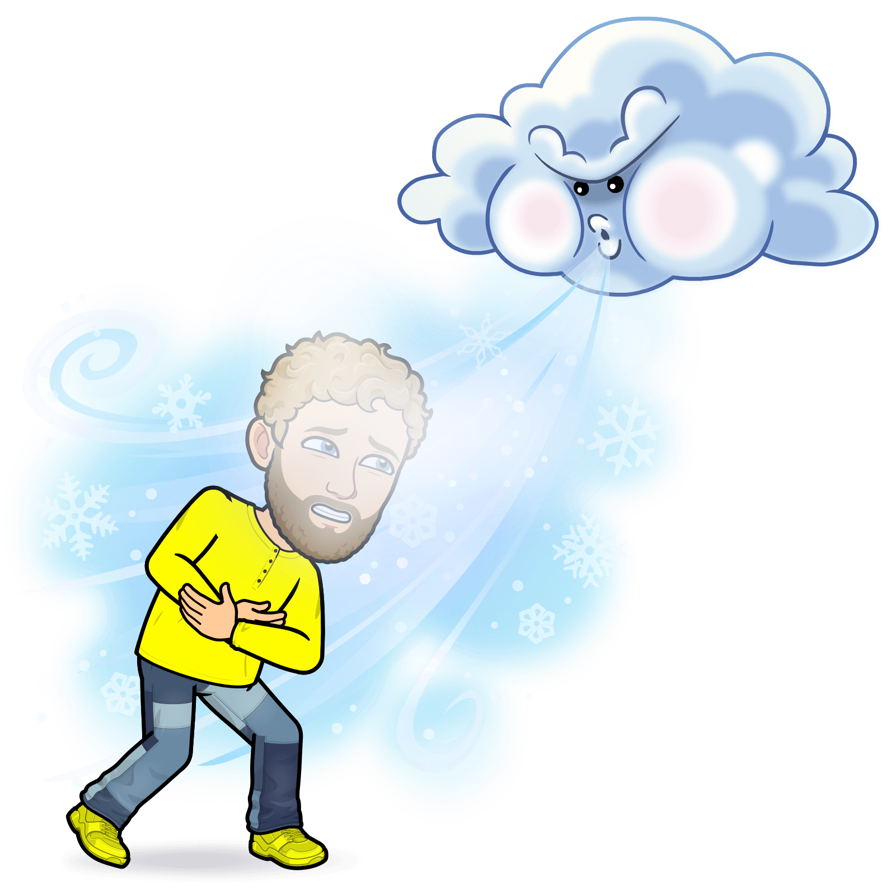
NEXT
rainy
cloudy
windy
sunny
snowy

Slide 13
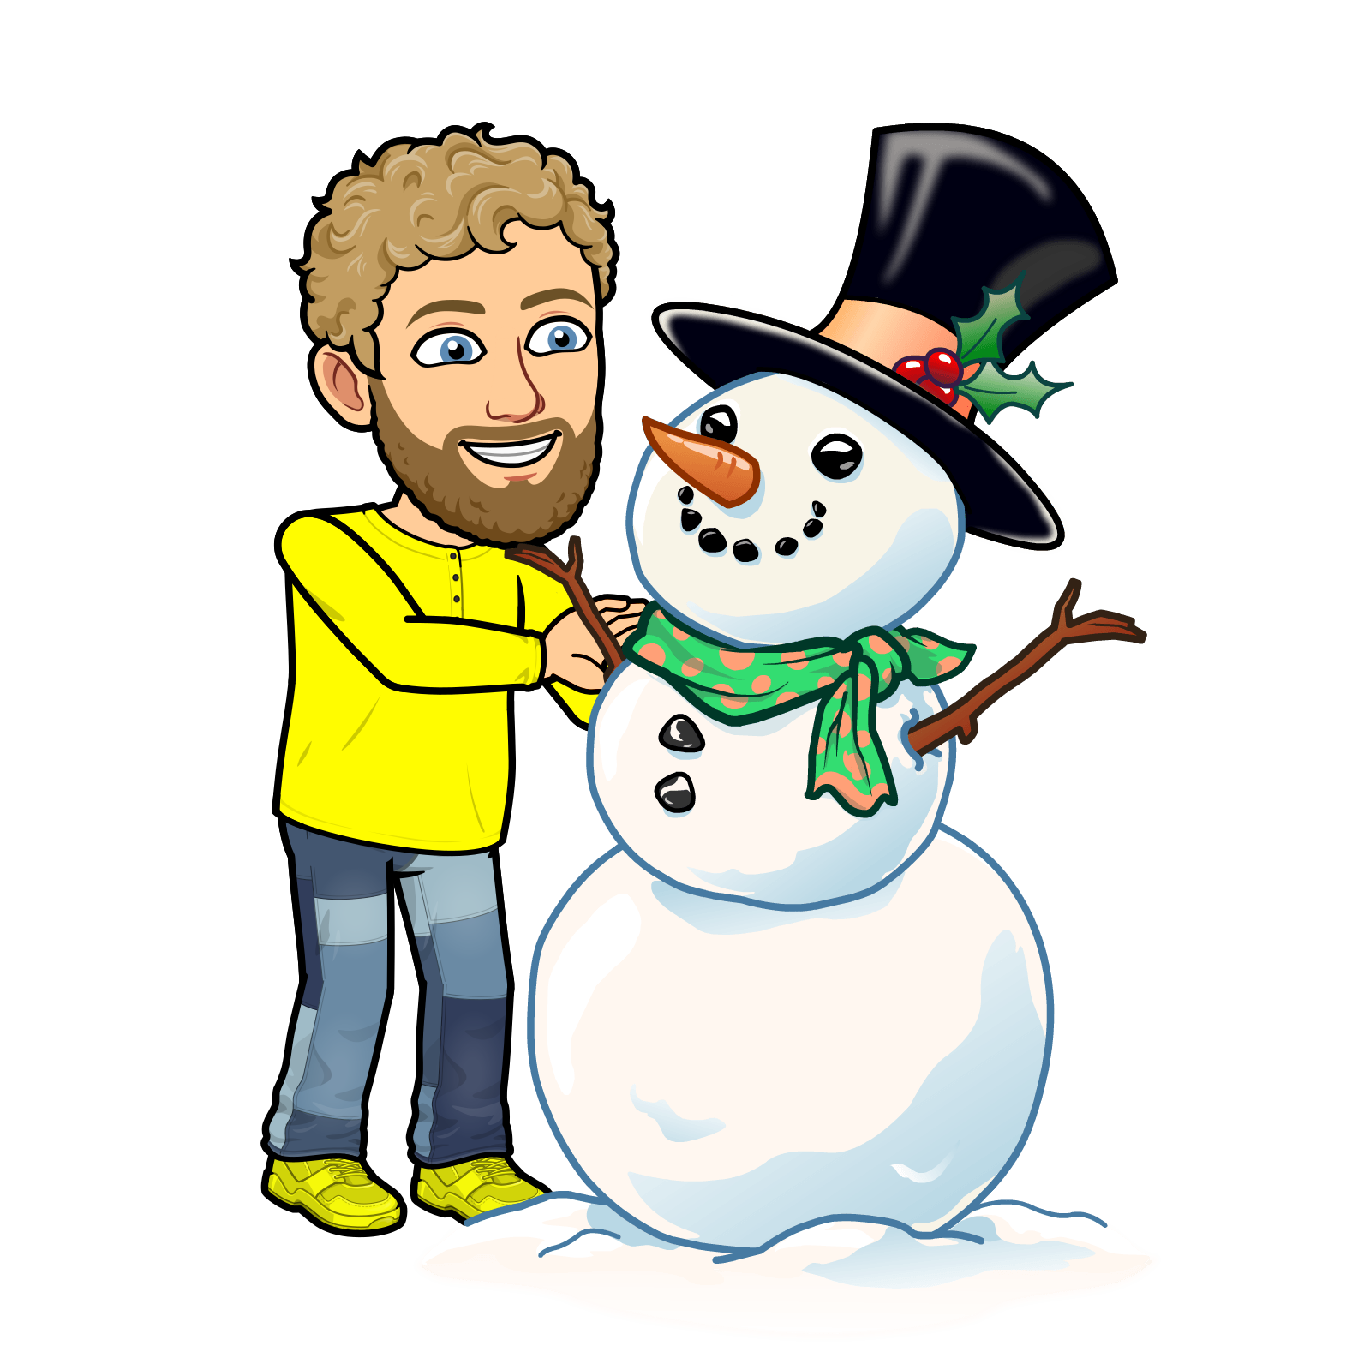
NEXT
rainy
cloudy
windy
sunny
snowy

Slide 14
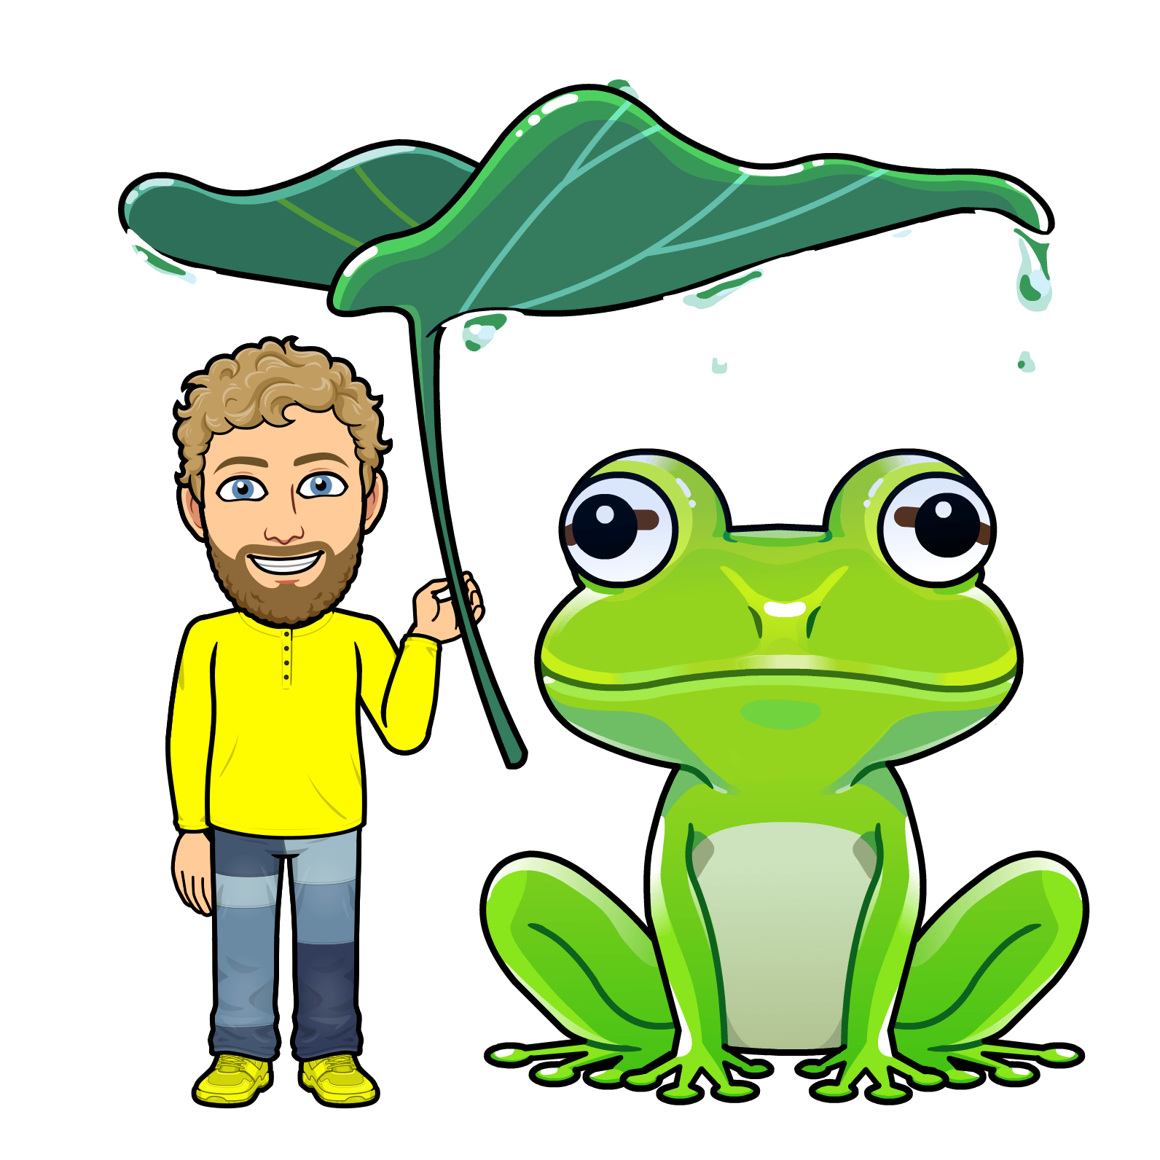
NEXT
rainy
cloudy
windy
sunny
snowy

Slide 15
NEXT
rainy
cloudy
windy
sunny
snowy

Slide 16
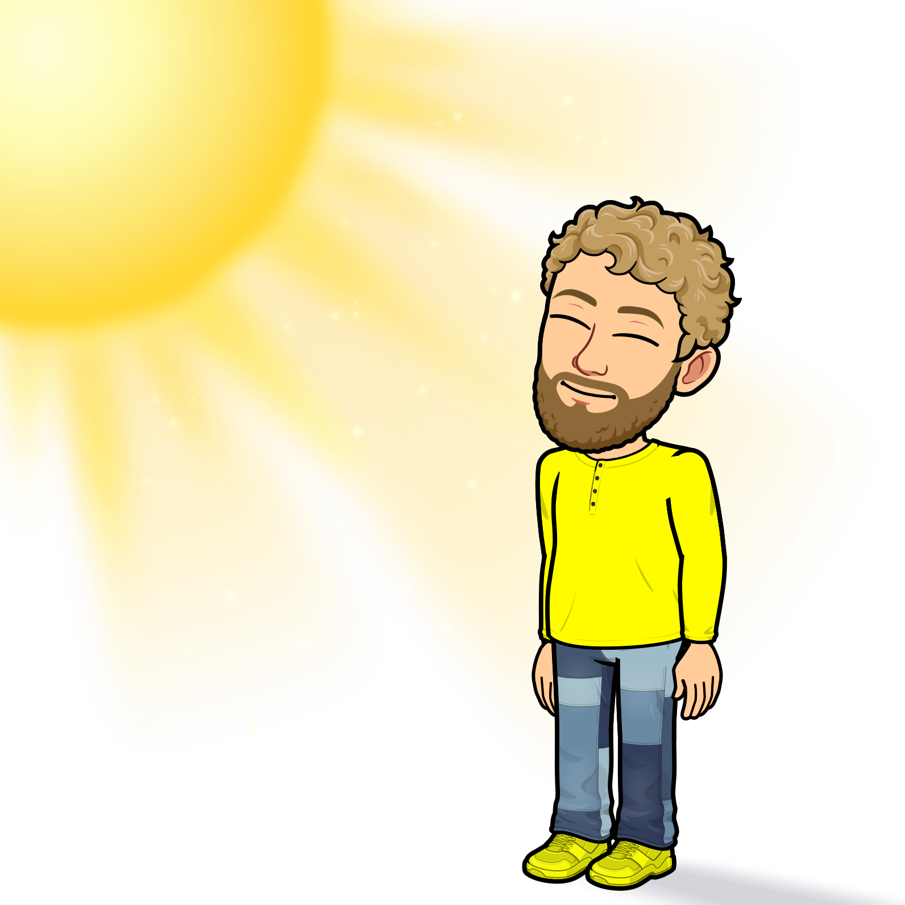
NEXT
rainy
cloudy
windy
sunny
snowy

Slide 17
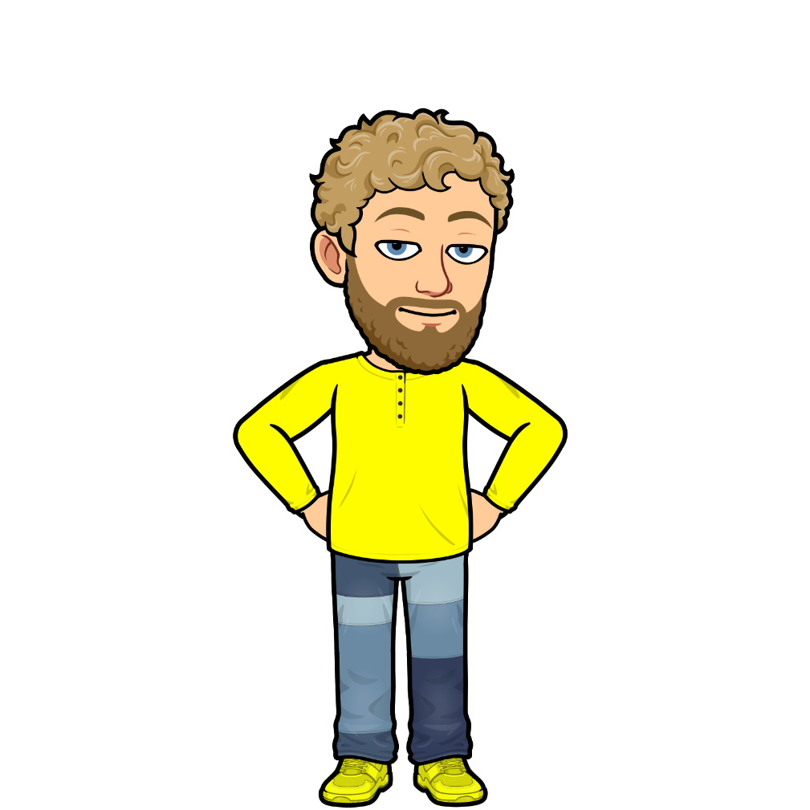
NEXT
rainy
cloudy
windy
sunny
snowy

Slide 18
NEXT
rainy
cloudy
windy
sunny
snowy

Slide 19
NEXT
rainy
cloudy
windy
sunny
snowy

Slide 20
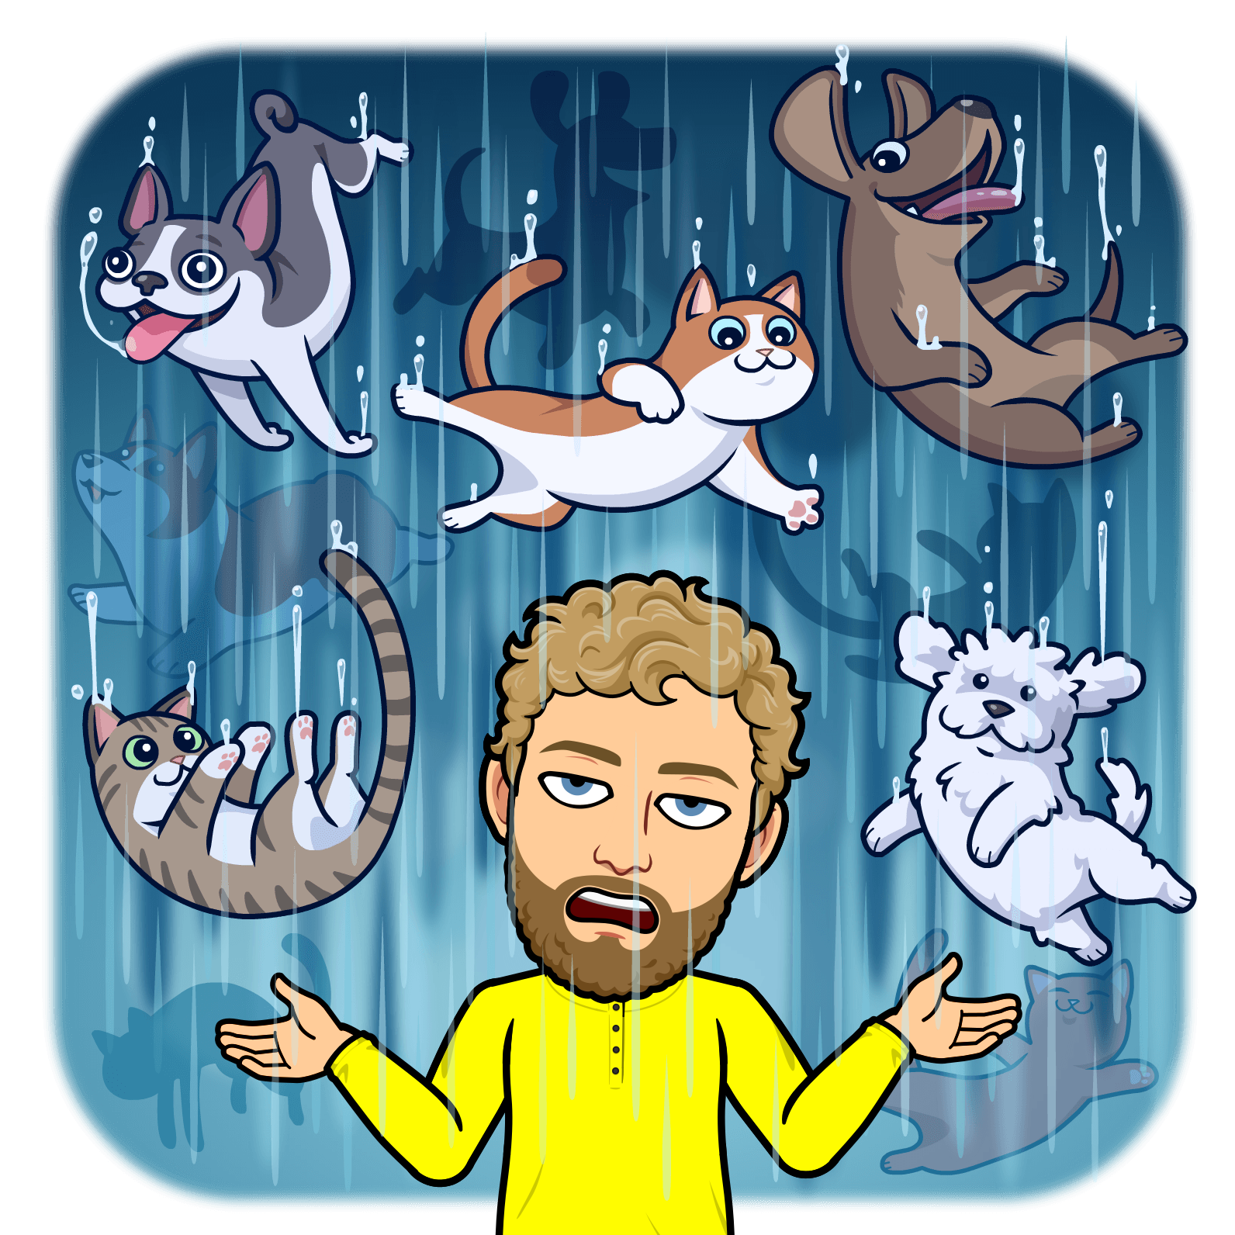
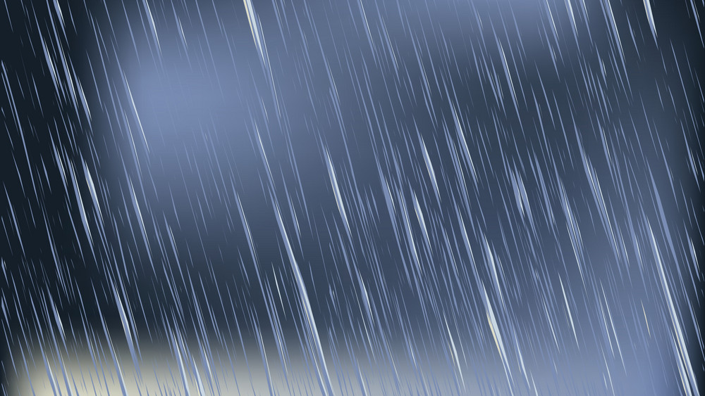
NEXT
rainy
cloudy
windy
sunny
snowy

Slide 21
NEXT
rainy
cloudy
windy
sunny
snowy

Slide 22
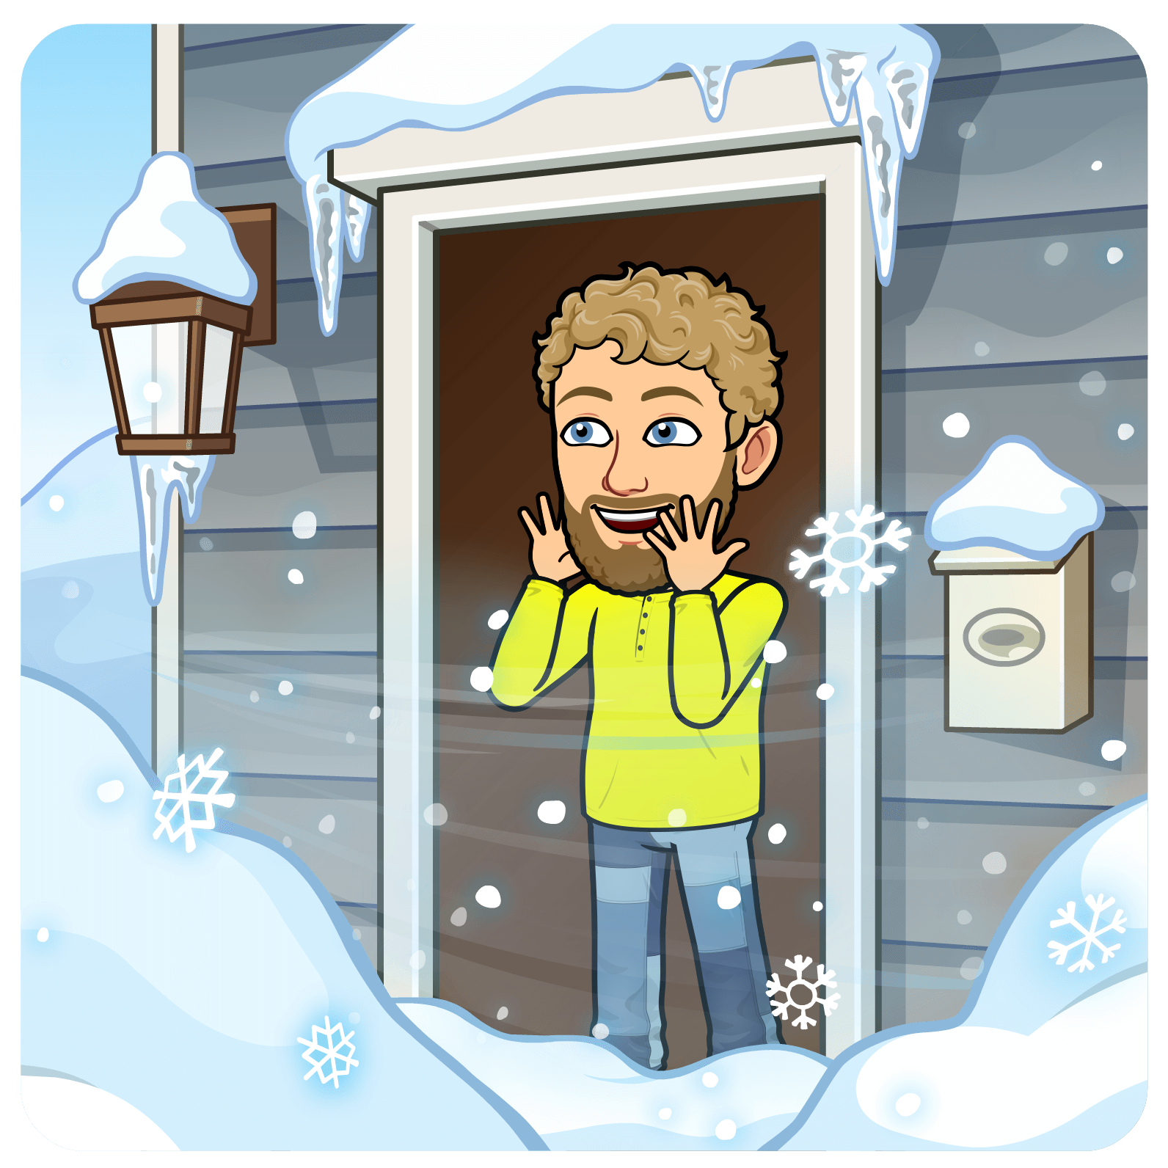
NEXT
rainy
cloudy
windy
sunny
snowy

Slide 23
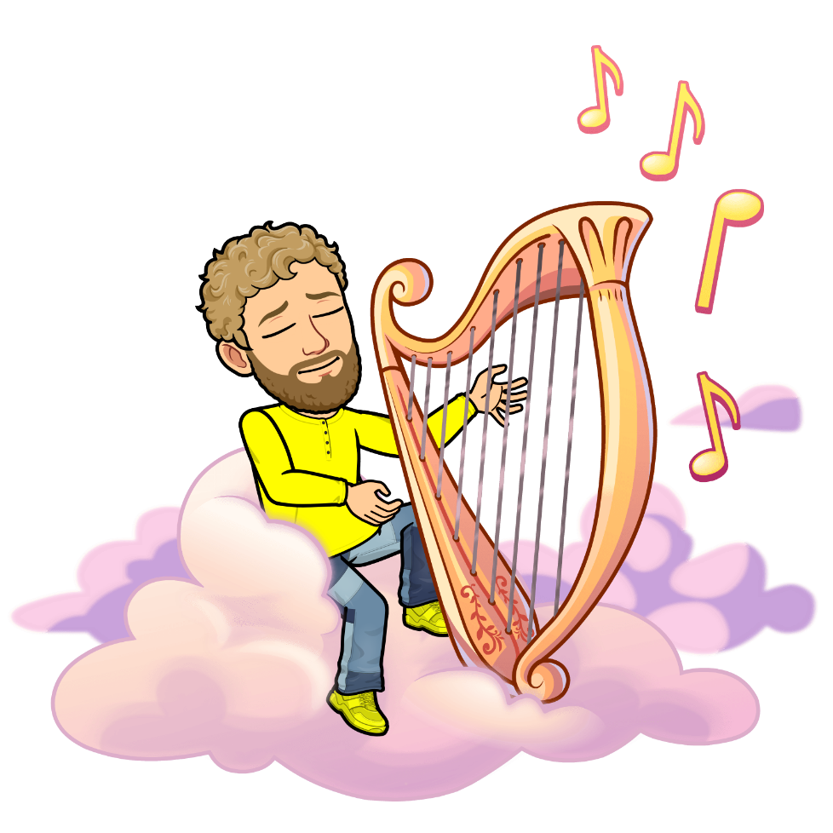
NEXT
rainy
cloudy
windy
sunny
snowy

Slide 24
END
rainy
cloudy
windy
sunny
snowy

