Slide 1
COUNT
THE
THINGS

Slide 2
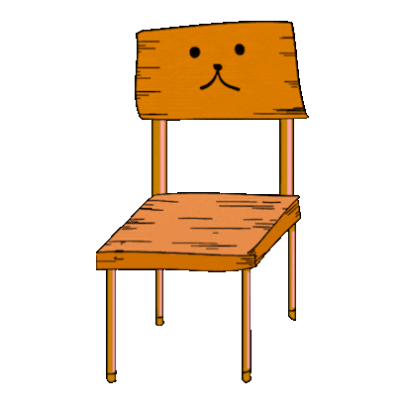
1
2
3
4
5
6
7
8
9
10
11
12
13
14
15
16
17
18
19
20
21
22
23
NEXT

Slide 3
1
2
3
4
5
6
7
8
9
10
11
12
13
14
15
16
17
18
19
20
21
22
23
NEXT

Slide 4
1
2
3
4
5
6
7
8
9
10
11
12
13
14
15
16
17
18
19
20
21
22
23
NEXT

Slide 5
1
2
3
4
5
6
7
8
9
10
11
12
13
14
15
16
17
18
19
20
21
22
23
NEXT

Slide 6
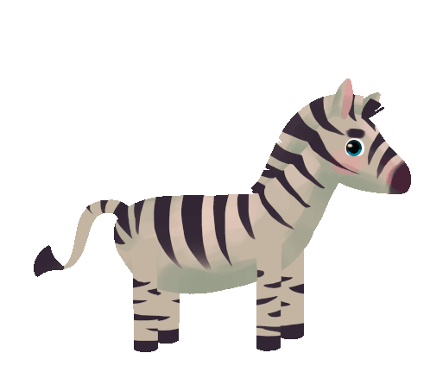
1
2
3
4
5
6
7
8
9
10
11
12
13
14
15
16
17
18
19
20
21
22
23
NEXT

Slide 7
1
2
3
4
5
6
7
8
9
10
11
12
13
14
15
16
17
18
19
20
21
22
23
NEXT

Slide 8
1
2
3
4
5
6
7
8
9
10
11
12
13
14
15
16
17
18
19
20
21
22
23
NEXT

Slide 9
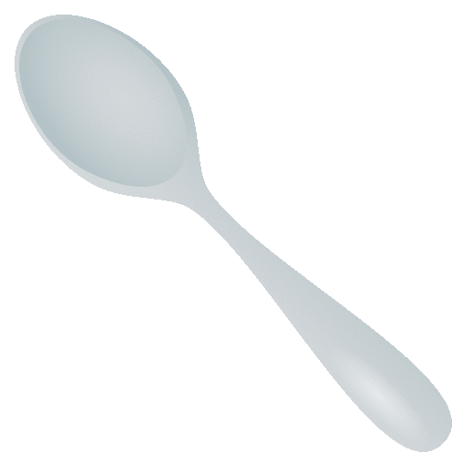
1
2
3
4
5
6
7
8
9
10
11
12
13
14
15
16
17
18
19
20
21
22
23
NEXT

Slide 10
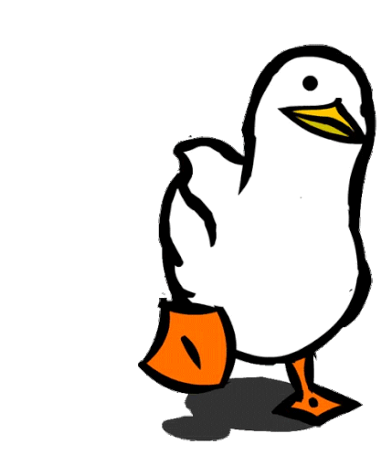
1
2
3
4
5
6
7
8
9
10
11
12
13
14
15
16
17
18
19
20
21
22
23
NEXT

Slide 11
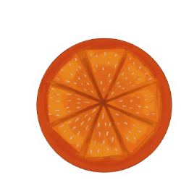
1
2
3
4
5
6
7
8
9
10
11
12
13
14
15
16
17
18
19
20
21
22
23
NEXT

Slide 12
1
2
3
4
5
6
7
8
9
10
11
12
13
14
15
16
17
18
19
20
21
22
23
NEXT

Slide 13
1
2
3
4
5
6
7
8
9
10
11
12
13
14
15
16
17
18
19
20
21
22
23
NEXT

Slide 14
1
2
3
4
5
6
7
8
9
10
11
12
13
14
15
16
17
18
19
20
21
22
23
NEXT

Slide 15
1
2
3
4
5
6
7
8
9
10
11
12
13
14
15
16
17
18
19
20
21
22
23
NEXT

Slide 16
1
2
3
4
5
6
7
8
9
10
11
12
13
14
15
16
17
18
19
20
21
22
23
NEXT

Slide 17
1
2
3
4
5
6
7
8
9
10
11
12
13
14
15
16
17
18
19
20
21
22
23
NEXT

Slide 18
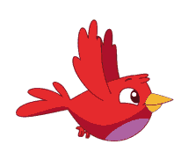
1
2
3
4
5
6
7
8
9
10
11
12
13
14
15
16
17
18
19
20
21
22
23
NEXT

Slide 19
1
2
3
4
5
6
7
8
9
10
11
12
13
14
15
16
17
18
19
20
21
22
23
NEXT

Slide 20
1
2
3
4
5
6
7
8
9
10
11
12
13
14
15
16
17
18
19
20
21
22
23
NEXT

Slide 21
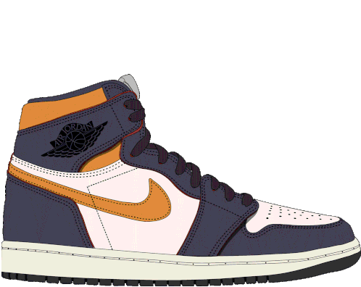
1
2
3
4
5
6
7
8
9
10
11
12
13
14
15
16
17
18
19
20
21
22
23
NEXT

Slide 22
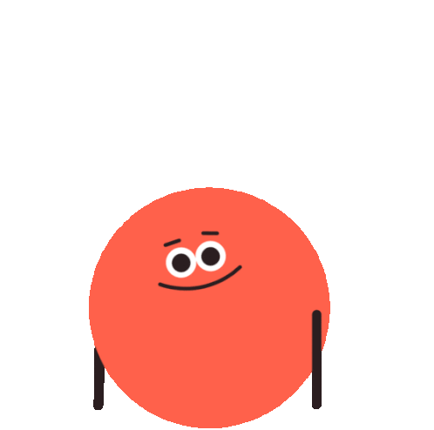
1
2
3
4
5
6
7
8
9
10
11
12
13
14
15
16
17
18
19
20
21
22
23
NEXT

Slide 23
1
2
3
4
5
6
7
8
9
10
11
12
13
14
15
16
17
18
19
20
21
22
23
NEXT

Slide 24
1
2
3
4
5
6
7
8
9
10
11
12
13
14
15
16
17
18
19
20
21
22
23
END

