Slide 1
What do I want to be?

Slide 2
“I want to be a BUILDER” said Mr. Warren.

Slide 3
“I want to be a FIREMAN” said Mr. Warren.

Slide 4
“I want to be a DOCTOR” said Mr. Warren.

Slide 5
“I want to be a NURSE” said Mr. Warren.

Slide 6
“I want to be a CHEF” said Mr. Warren.

Slide 7
“I want to be a VET” said Mr. Warren.

Slide 8
“I want to be a ASTRONAUT” said Mr. Warren.

Slide 9
“I want to be a BUS DRIVER” said Mr. Warren.

Slide 10
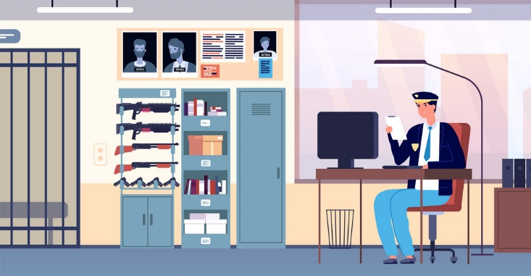
“I want to be a POLICEMAN” said Mr. Warren.

Slide 11
“I want to be a
SHOP KEEPER” said Mr. Warren.

Slide 12
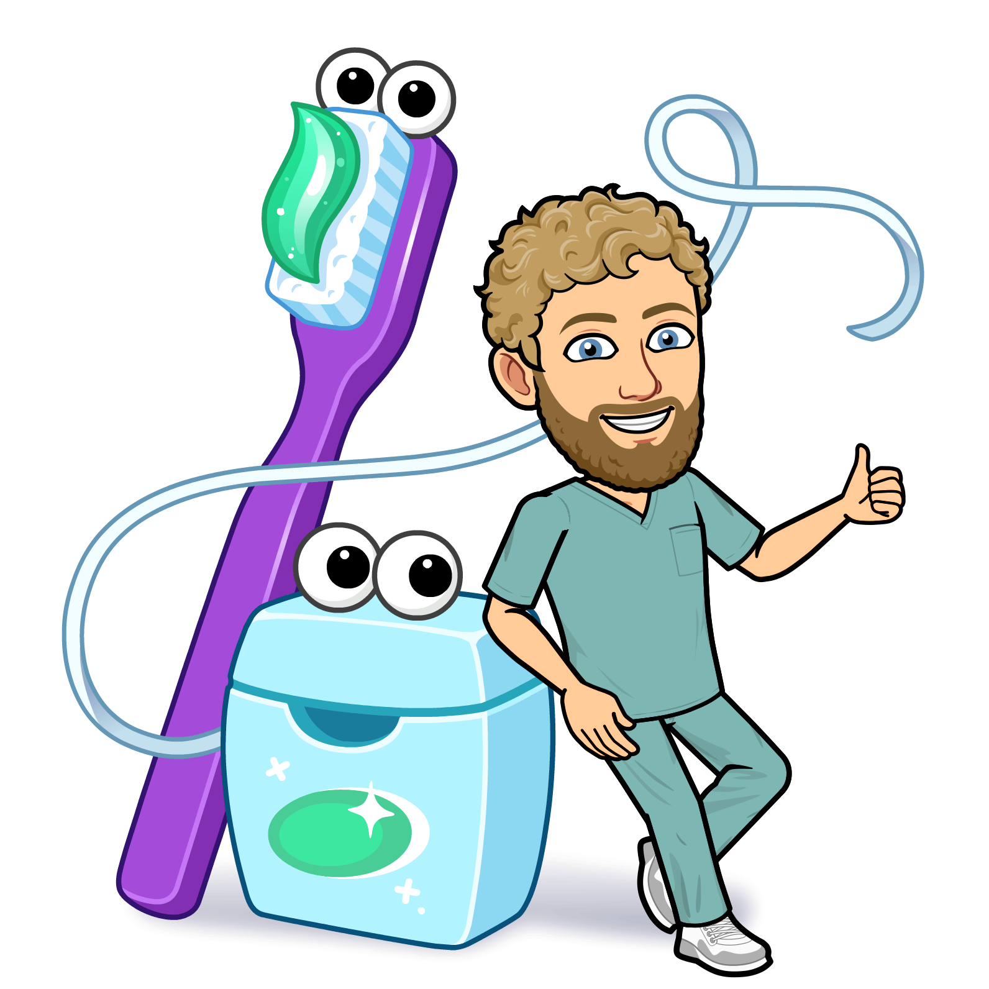
“I want to be a DENTIST” said Mr. Warren.

Slide 13
“I want to be a WAITER” said Mr. Warren.

Slide 14
“I want to be a FARMER” said Mr. Warren.

Slide 15
“Oh! I know
what I want
to be!”
shouts
Mr. Warren.

Slide 16
“I want to be a TEACHER!” said Mr. Warren.

